Slide 1
The Political Economy of Greenwashing
Spatialising the Myth of Immateriality in Virtual Production and Digital Spatial Fix
Hanpu Li
Notes:
Good morning, everyone. My name is Hanpu Li. Today, I am going to share a forensic spatial audit with you, titled: The Political Economy of Greenwashing. We are going to look at the hidden physical costs of the so-called "immaterial" digital cloud. Texts on slides might be intensive, and you don’t need to read everything.

Slide 2
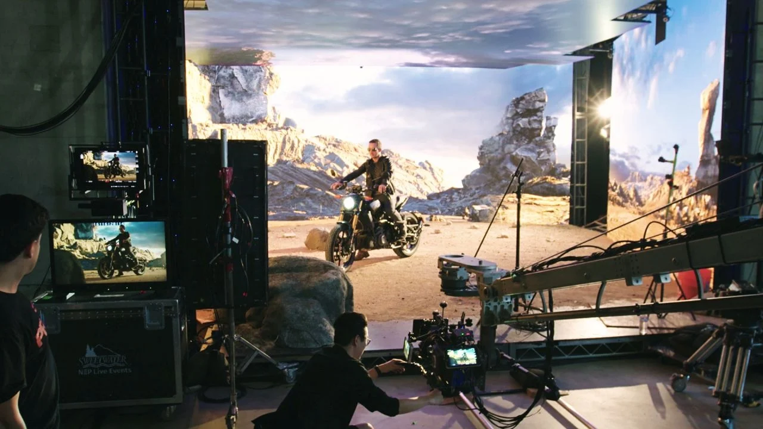
Fig. 1. Promotional imagery for Epic Games' Virtual Production curriculum (Animation World Network, 2020).
Notes:
When the film industry promotes "Virtual Production"—using massive LED screens to replace real-world filming locations—they sell us a beautiful story. They tell us that by not flying crews around the world, making movies is now a sustainable, low-carbon, and "virtual" process.

Slide 3
Research Question & Contribution
Research Question
How does virtual production, framed as a low-carbon digital alternative, reorganise land use, energy demand and spatial governance at the metropolitan periphery?
Contribution
Conceptually: situates virtual production within the Digital Spatial Fix
Methodologically: develops a replicable forensic spatial audit pipeline
Empirically: quantifies spatial, discursive and economic asymmetries in the Shepperton expansion
Notes:
My research asks a simple but critical question: Does this digital technology actually save the environment, or does it just hide the damage? My goal today is to quantify the very real, physical footprint of this "virtual" alternative.

Slide 4
Situation
Growth of Virtual Production in UK screen industries
Framed as sustainable alternative to location shooting
Case: Shepperton Studios Expansion
Virtual production is widely framed as a decarbonisation strategy.
Virtual production operates as a technological veneer for renewed rounds of spatial expansion and resource appropriation.
Notes:
To establish the SITUATION, we are looking at the massive expansion of Virtual Production hubs here in the UK, specifically the Shepperton Studios expansion. While the industry frames this as an eco-friendly move, my audit reveals it is actually a cover for aggressive land expansion.

Slide 5
Theoretical Framework: a Marxist Political Economy Approach
Media Materiality (Bozak, 2012)
Digital media always depend on physical infrastructures and resource extraction.
The Jevons Paradox (Sharma, 2024)
Efficiency gains can increase total energy consumption.
The Digital Spatial Fix (Greene & Joseph, 2015)
Virtual production functions as a capitalist spatial fix: a strategy through which capital resolves its own crises by expanding into new territories, infrastructures and ecological capacities.
Accumulation by Dispossession (Harvey, 2004)
Digital expansion requires the continual appropriation of land, energy and ecological capacity.
Notes:
I look at this through the lens of Political Economy. There is a concept called the "Digital Spatial Fix." In plain English, this means that digital capitalism doesn't actually get rid of pollution or crisis; it simply moves it somewhere else. We are just shifting the environmental damage from airplane skies down into local neighborhoods.

Slide 6
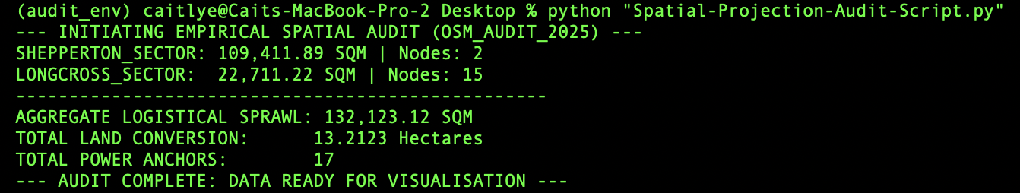
Methodology: Audit Pipeline
> 01_RAW_MINING: Overpass API (OSM)
> 02_SPATIAL_PROJECTION: Python (WGS84 → EPSG:27700)
> 03_DISCOURSE_AUDIT: Retrieval-Augmented Critical Discourse Analysis (CDA)
[Corpus: Spelthorne Municipal Grey Literature & Planning Dossiers]
Terminal Output:
AGGREGATE_LOGISTICAL_SPRAWL: 132,123.12 SQM
TOTAL_LAND_CONVERSION: 13.2123 Hectares
TOTAL_POWER_ANCHORS: 17
Semantic Deconstruction:
“The proposed development is in a highly sustainable location and will provide a range of social, economic and environmental benefits.” (Turley, 2018)
"The prospective applicant has indicated an intention to improve the ecological condition... and to deliver improvements to the wider site in terms of biodiversity.” (Spelthorne Borough Council, 2018)
132,123.11 SQM Logistical Sprawl (Asphalt expansion)
5.4 GWh/year (regulated demand, excluding tenant fit-out and unregulated loads)
79+ Mature Trees Removed (as per Environmental Statement, 2018)
£36,150 S106 (all transport fees; £0 ecological) vs. £322.7M/yr operational GVA)
Fig. 2. Terminal output of the spatial audit pipeline (OSM_AUDIT_2025). Aggregate metrics calculate total land conversion at 13.2123 hectares. Author's own execution.
Notes:
To prove this, I couldn't just trust corporate PR reports. I built a custom, automated tool using Python. I pulled raw mapping data directly from OpenStreetMap, and used a mathematical projection to convert global GPS coordinates into exact physical square meters. This gave me sub-metre accuracy that corporate reports couldn't hide from.

Slide 7
Methodological Note (Data Scope & Limits)
OSM extraction date: March 2026
Logistical sprawl defined as: parking, service roads, impermeable service yards
Power anchors identified via substation and high-capacity grid nodes tagged in OSM
NO2 projection based on AADT modelling from i-Transport (2018) baseline
OSM data accuracy ~85-95% for tagged infrastructure (per OSM wiki); projection error <0.1% at EPSG:27700 scale.

Slide 8
Problem
The problem lies in the hidden material expansion behind claims of immateriality.
Notes:
This leads us to the core PROBLEM. The problem is that the "cloud" requires massive physical expansion on the ground.

Slide 9
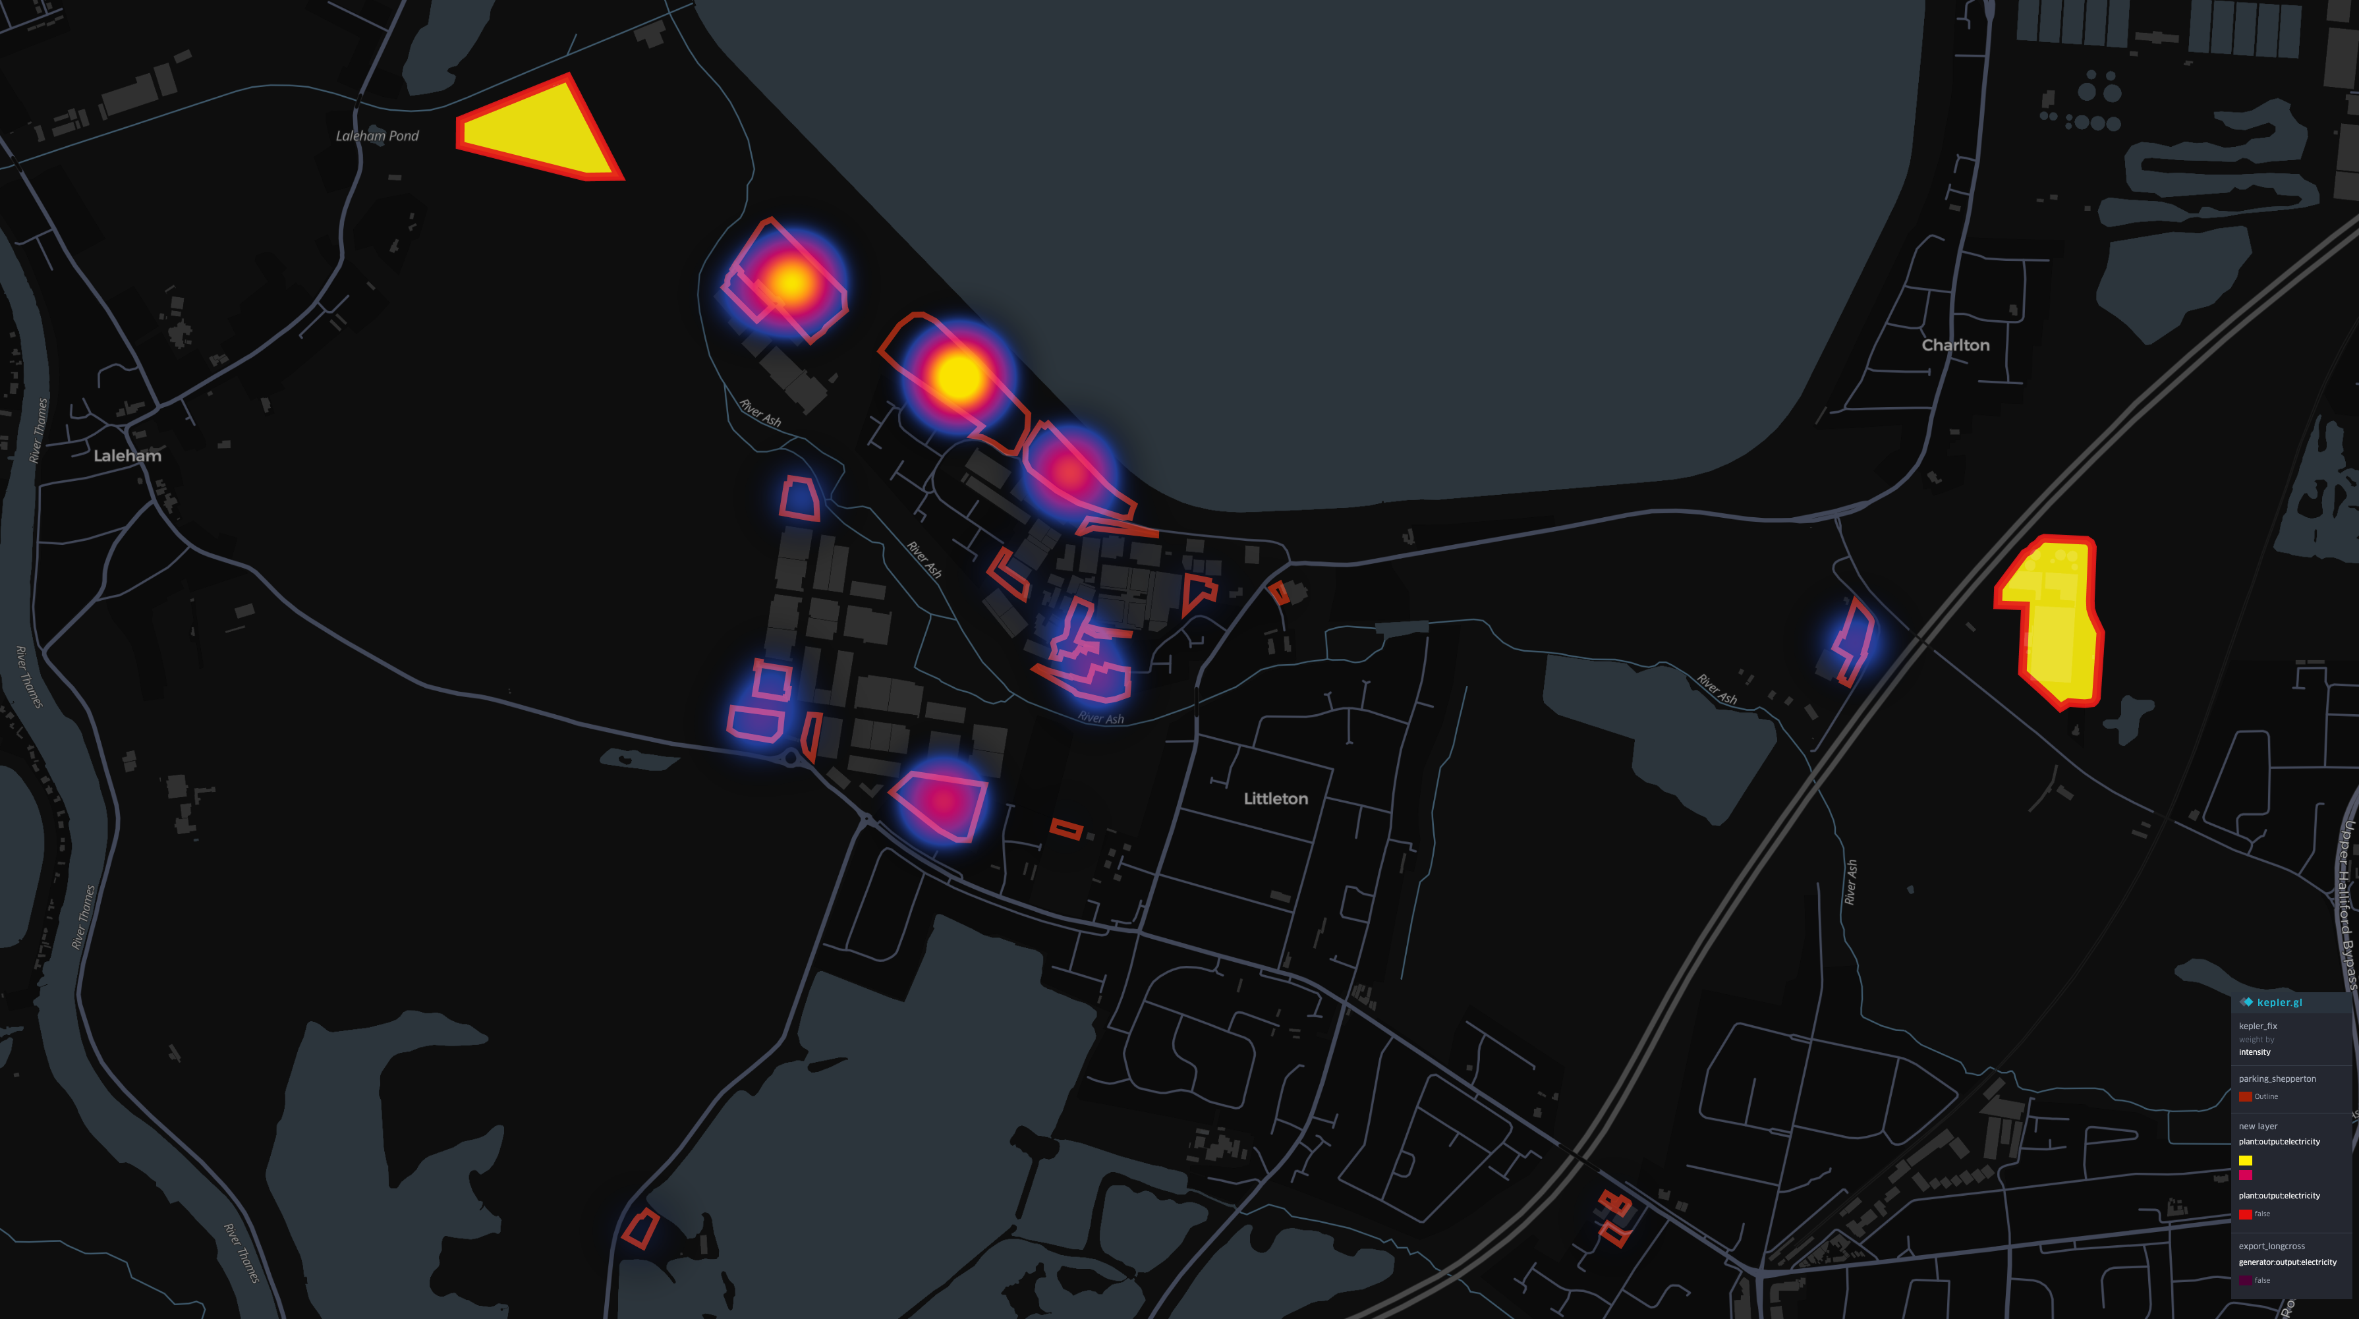
Spatial-Ecological Imbalance
Aggregate Logistical Sprawl: 132,123.11 sqm
Parking Bays: 2845
Logistical sprawl (impervious): 13.21 Hectares*
Traffic Rebound (AADT): +703 Vehicles/Day
(Source: i-Transport, 2018, Table 5.14)
Atmospheric Compromise: NO2 +2.19 μg/m³
(Source: Turley, ES Vol 1, Air Quality Assessment)
Power elements (OSM power=*): 17 (indicative lower bound)
This logistical sprawl constitutes the spatial fix demanded by digital capital to sustain accumulation cycles.
*Equivalent to paving over 18.5 professional football pitches.
Notes:
My audit extracted staggering numbers. The logistical sprawl—meaning new parking lots and concrete—equates to over 13.2 hectares. That is the equivalent of paving over 18.5 professional football pitches.

Slide 10
Geovisualisation of Shepperton expansion vectors. Data sourced from OSM_AUDIT_2025 repository.
Notes:
If you look at the map on the screen, the glowing red zones show asphalt expanding across the greenbelt.

Slide 11
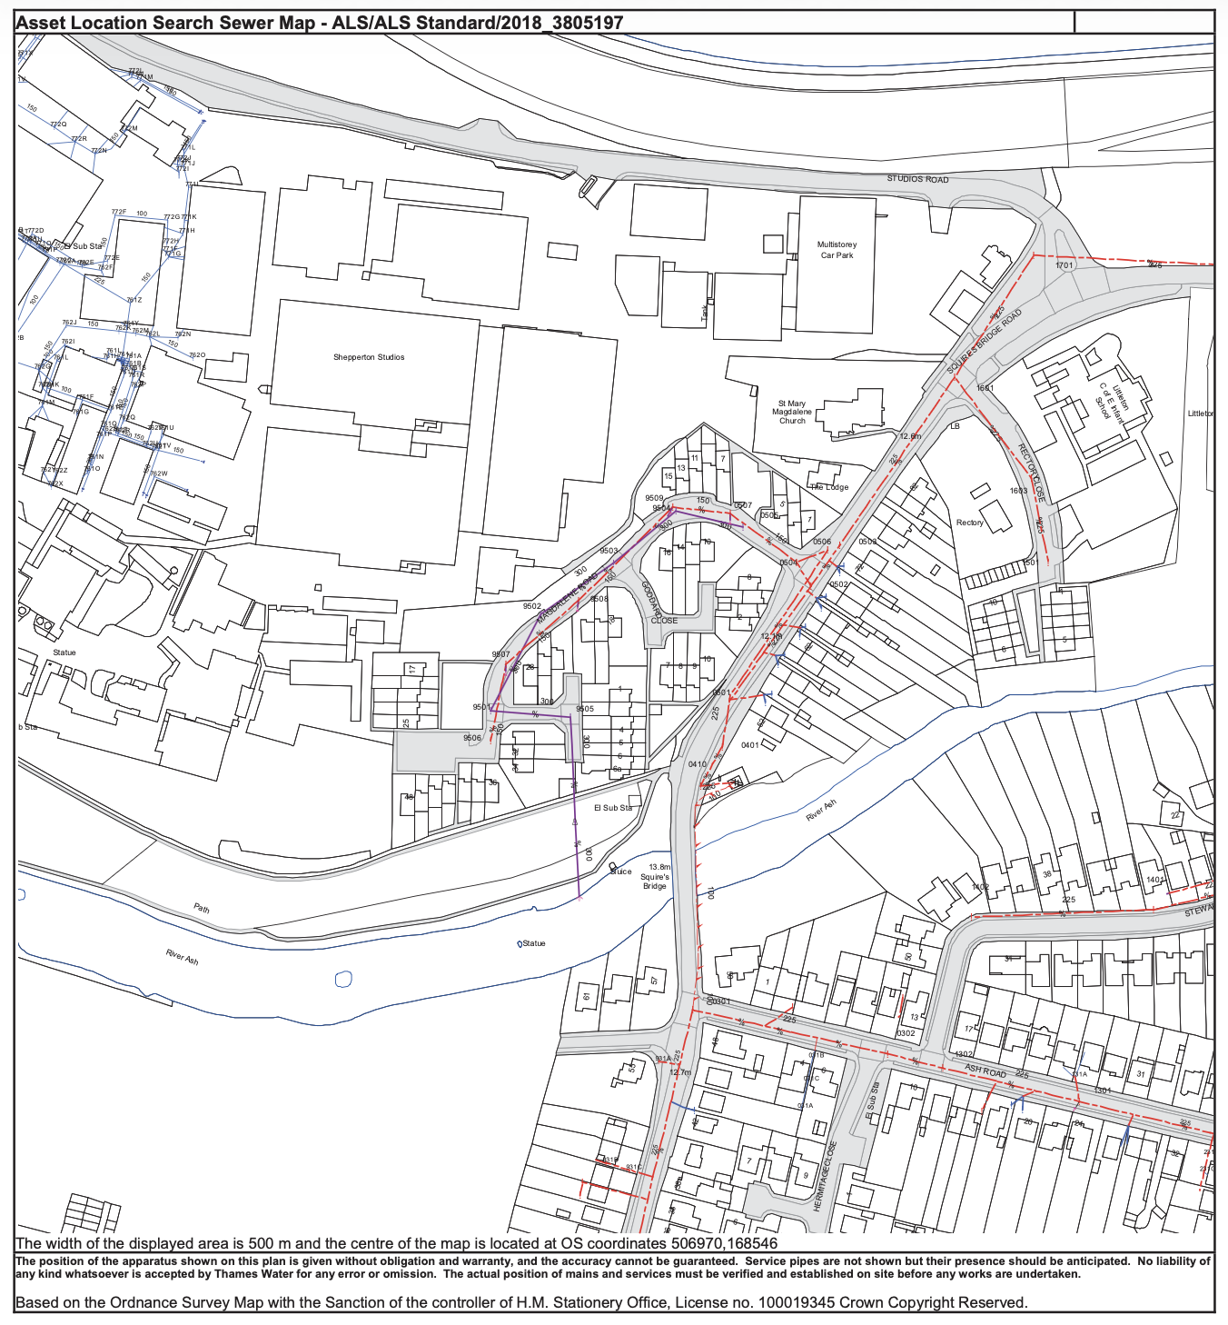
For each mid-size production:
Base Power Draw: 2x 1200 Amp + 2x 250 Amp Diesel Generators
Combustion rate: 296 Litres of Diesel / Day
Climate Cost: 52 Tonnes GHG Emissions
(CMPA / Felder et al., 2022)
Source: Asset Location Search Map (Hydrock, 2018, p. 6).
Notes:
And the disruption goes deep underground, as we can see from this Thames Water engineering map required to support these digital stages, with also El Sub Stns.

Slide 12
Implications (Preview)
Environmental: loss of biomass, NDVI collapse, heat accumulation
Economic: 5.4 GWh/year new loads, escalation of local infrastructure cost
Governance: discourse‑led legitimisation of expansion
Notes:
The IMPLICATIONS of this sprawl are severe across three dimensions: environmental, economic, and governance.

Slide 13
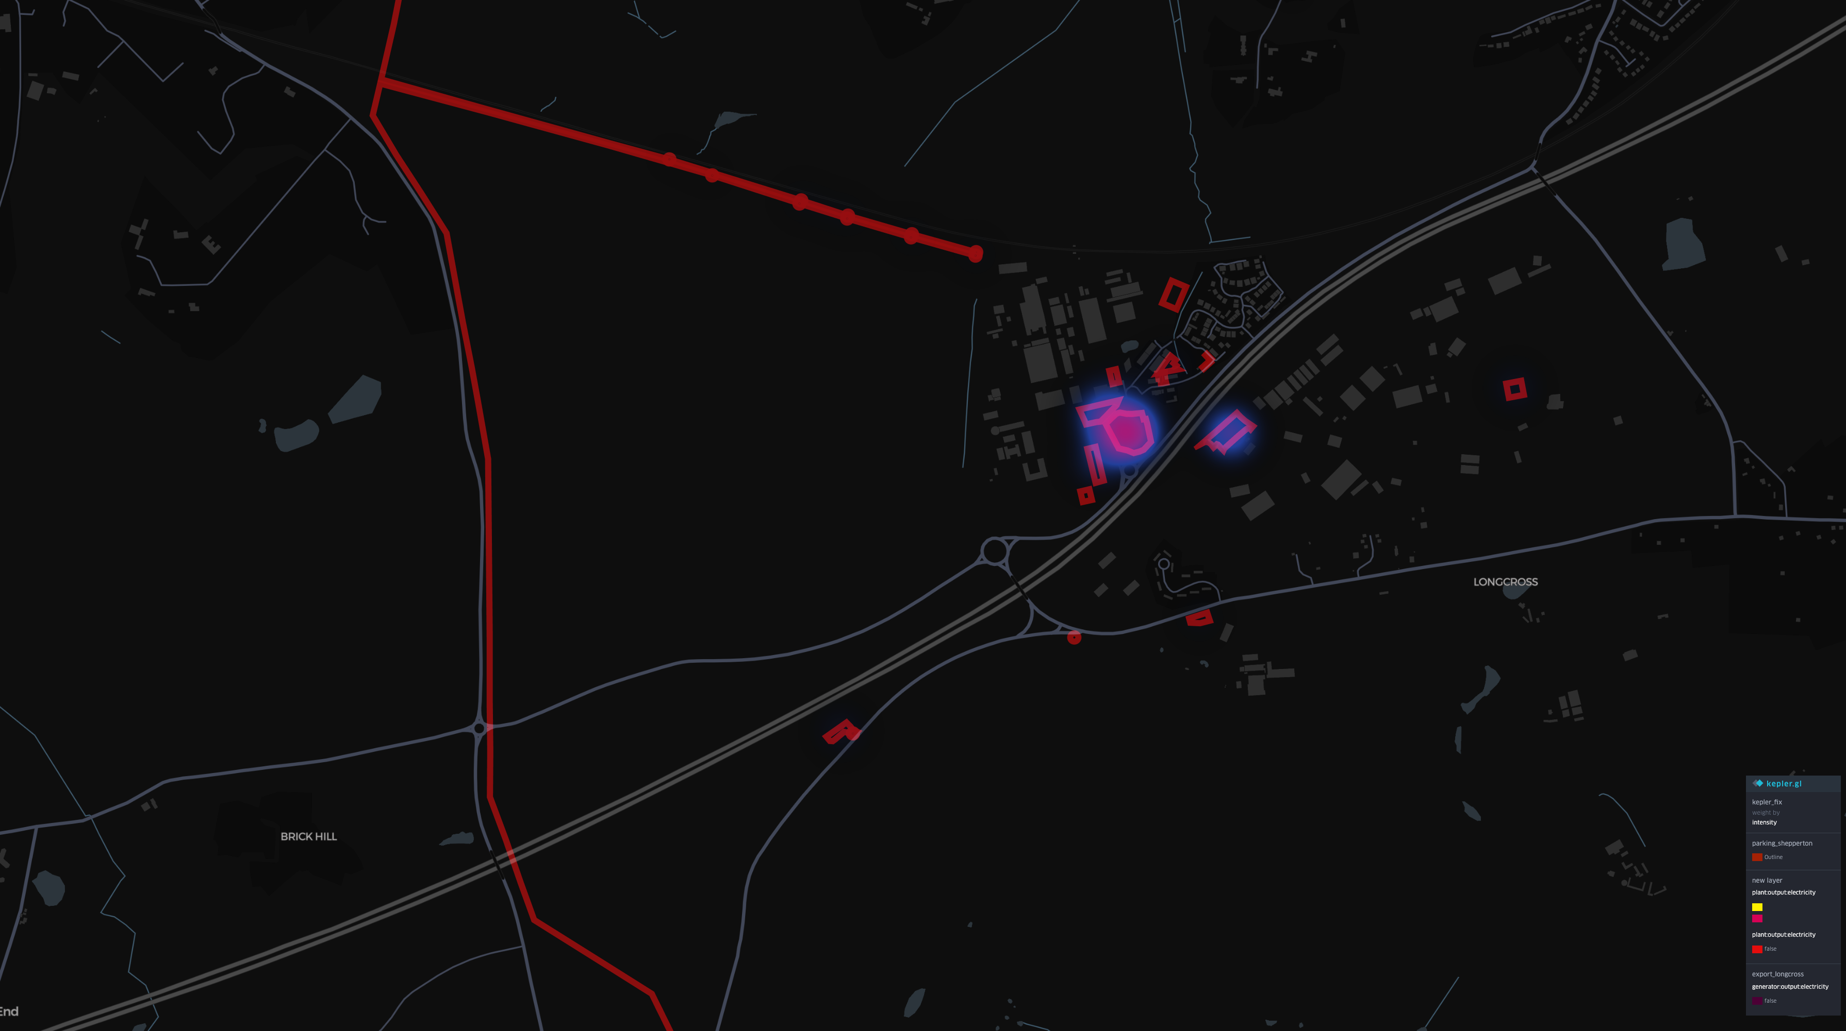
Land, Flood Risk & Ecological Loss
High-Capacity Grid Dependence: 5.4 GWh/Year Regulated Energy Demand
5,396,561 kWh
Hydrological Control : 39 Hectares in Flood Zone 2 Hardsurfaced
Physical Erasure: 79+ MATURE TREES REMOVED
This reflects what political ecology calls a violent discipline of nature.
Notes:
Economically, these new LED stages are incredibly power-hungry. My data shows they demand 5.4 Gigawatt-hours of energy every single year. Environmentally, they require taking control of 39 hectares of natural flood zones.

Slide 14
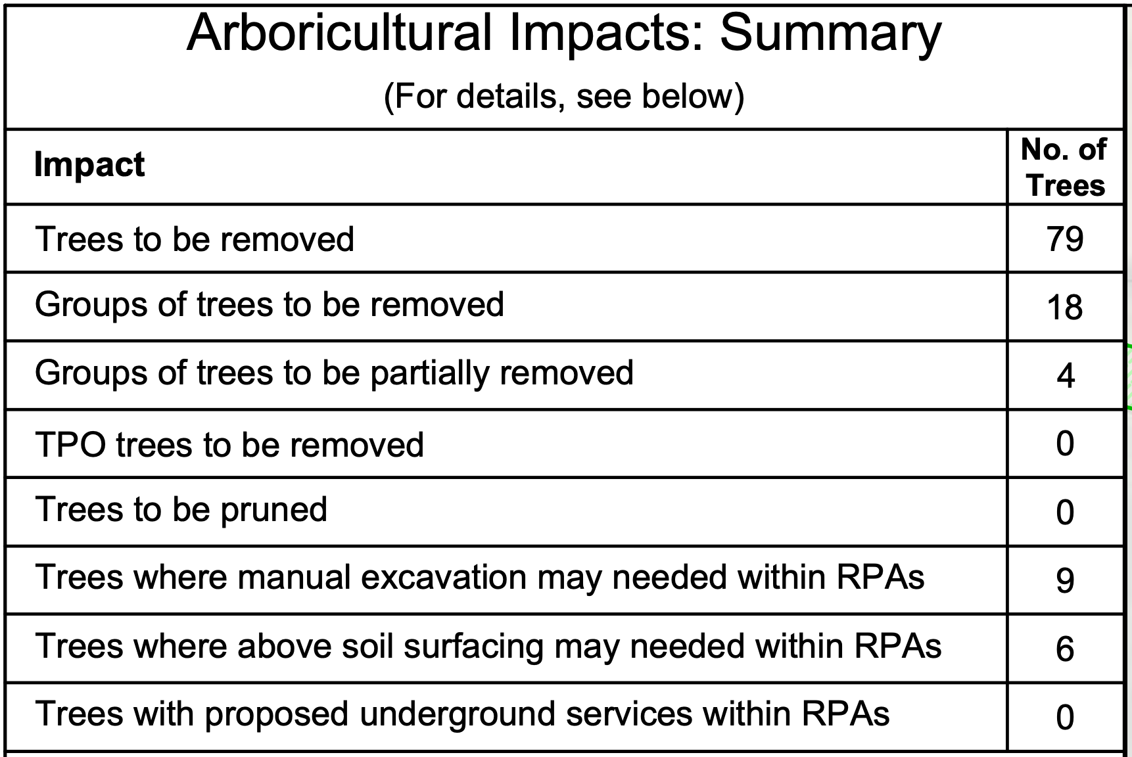
Table 1. Summary of arboricultural impacts. Extracted from Spelthorne Borough Council Planning Dossier 18/01212/OUT (Arboricultural Implications Report, August 2018).
Notes:
To make way for this concrete, biological life is erased. Official planning documents confirm the removal of 79 mature trees.

Slide 15
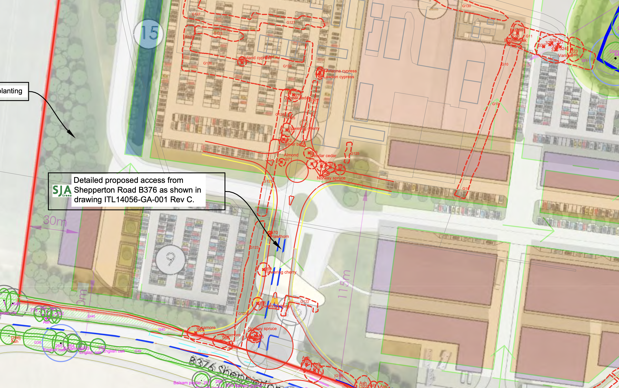
Fig 2: SJA Trees (2018) Tree Protection Plan. Drawing No: SJA TPP 18158-02.
Notes:
The tree protection plans show exactly where nature was bulldozed for digital screens.

Slide 16
Institutional Complicity & Moral Licensing
£322.7M / yr
Operational GVA per annum (Capital Fix)
(Turley Economics, 2018, para 33; Table 6.2’s £392M is the 4-yr construction-period total, not annual)
£36,150*
Total S106 — entirely transport fees; £0 ecological
(Spelthorne Borough Council, 2019)
(transport admin only)
*£36,150 = Travel Plan £6,150 + Parking Review £10,000 + Signage £20,000. No ecological compensation for 39 ha greenbelt.
Notes:
But the most shocking implication is the financial reality. This expansion generates an immense £392 Million in Annual Value for the industry. Yet, the ecological compensation fee paid to the local council was a mere £6,150. That is a fraction of a percent. The industry privatises the massive profits, while making the local community pay the environmental price.

Slide 17
Feasibility
Uses already available spatial data (OSM)
The audit methodology leverages open-source Volunteered Geographic Information, specifically OpenStreetMap via the Overpass API, to extract hard spatial metrics. This circumvents the industry’s ‘selective visibility’ by utilising publicly accessible geographic data to quantify physical infrastructure, such as high-voltage nodes and logistical sprawl, without relying on proprietary corporate disclosures.
Can be integrated into existing EIA processes
This forensic framework is highly feasible as it directly interfaces with the statutory frameworks already mandated by the EIA Regulations 2017. By applying Natural Language Processing and spatial quantification to standard planning dossiers, local authorities can systematically reverse-read institutional euphemisms to expose the exact material costs, such as energy demand and habitat erasure, already documented within developer submissions. (Spelthorne Borough Council, 2018; Turley, 2018)
Scalable across UK production hubs
Because the spatial projection utilises the standardised British National Grid (EPSG:27700), this algorithmic audit is universally scalable across the entire UK screen sector. It can be systematically deployed to quantify the cumulative spatial fix and metabolic rift across expanding megahubs, tracking continuous capital territorialisation from Shepperton down to the Longcross and Leavesden clusters. (PwC, 2018; Greene and Joseph, 2015)
Notes:
Looking at the FEASIBILITY of my method: because I used free, open-source data and standard Python scripts, this audit is incredibly practical. It can be adopted by any local council tomorrow to double-check corporate environmental claims without needing expensive software.

Slide 18
Epistemological Limits & Future Trajectories
1. Geospatial: Time-Series Remote Sensing
Limit: OSM latency (Jan ‘26) and static mapping.
Why Not: Deploy Google Earth Engine & Sentinel 2 data for NDVI verification.
2. Thermodynamic: Micro-Attribution
Limit: Macro-grid aggregation.
Why Not: HVAC & server cooling load regression modelling.
3. Algorithmic: The "Hypocrisy Index"
Limit: Manual CDA bottleneck.
Why Not: Automated NLP scraping of corporate ESG reports.
4. Logistical: Telemetric Falsification
Limit: Reliance on 2018 EIA predictive models.
Why Not: Live Traffic API monitoring (TomTom/Google Maps Traffic).
Notes:
However, my initial map data had a limitation. Maps are static. They tell us where the concrete is, but they don't show us the living environment dying over time, don’t rely on real-time data, and can be PR-manipulated as well. With time and budget limited, I still have some thoughts on potential, future steps.

Slide 19
So Why Not…
Notes:
So... why not just do it?

Slide 20
Part II:
Earth Observation & Metabolic Quantification
Empirical Quantification of Biophysical Erasure and Localised Thermal Anomalies
(Bonus)
Hanpu Li
Notes:
Welcome to Part Two: Earth Observation.

Slide 21
ST & EO Pipeline (GEE API)
1. Core EO Datasets
ESA Sentinel-2 (S2_SR_HARMONIZED): 10 m multispectral imagery for vegetation dynamics
USGS Landsat 7 + 8 + 9 (Collection 2, Tier 1, Level 2 - TIRS): 100 m thermal infrared data for land‑surface temperature
2. Cloud‑Masking & Temporal Normalisation
-GEE QA60 bitwise cloud‑masking to remove atmospheric interference.
-Raw per-overpass observations (Python: pandas, NumPy) — no smoothing applied; trend/significance via Newey-West HAC OLS + Seasonal Mann-Kendall on raw/monthly data (DiD vs Control Zone).
-dropna() filtering to purge cloud‑induced null artefacts in thermal data.
3. Minimal Open‑Source Processing Stack
Google Earth Engine JavaScript API for NDVI and LST computation.
Python for local regression, time‑series cleaning, and chart rendering.
Entire workflow is fully open‑source, scalable, and reproducible without proprietary GIS software.
Notes:
To find the ultimate proof, I built a secondary pipeline using Google Earth Engine, pulling data from European and American satellites over an 8-year period.

Slide 22
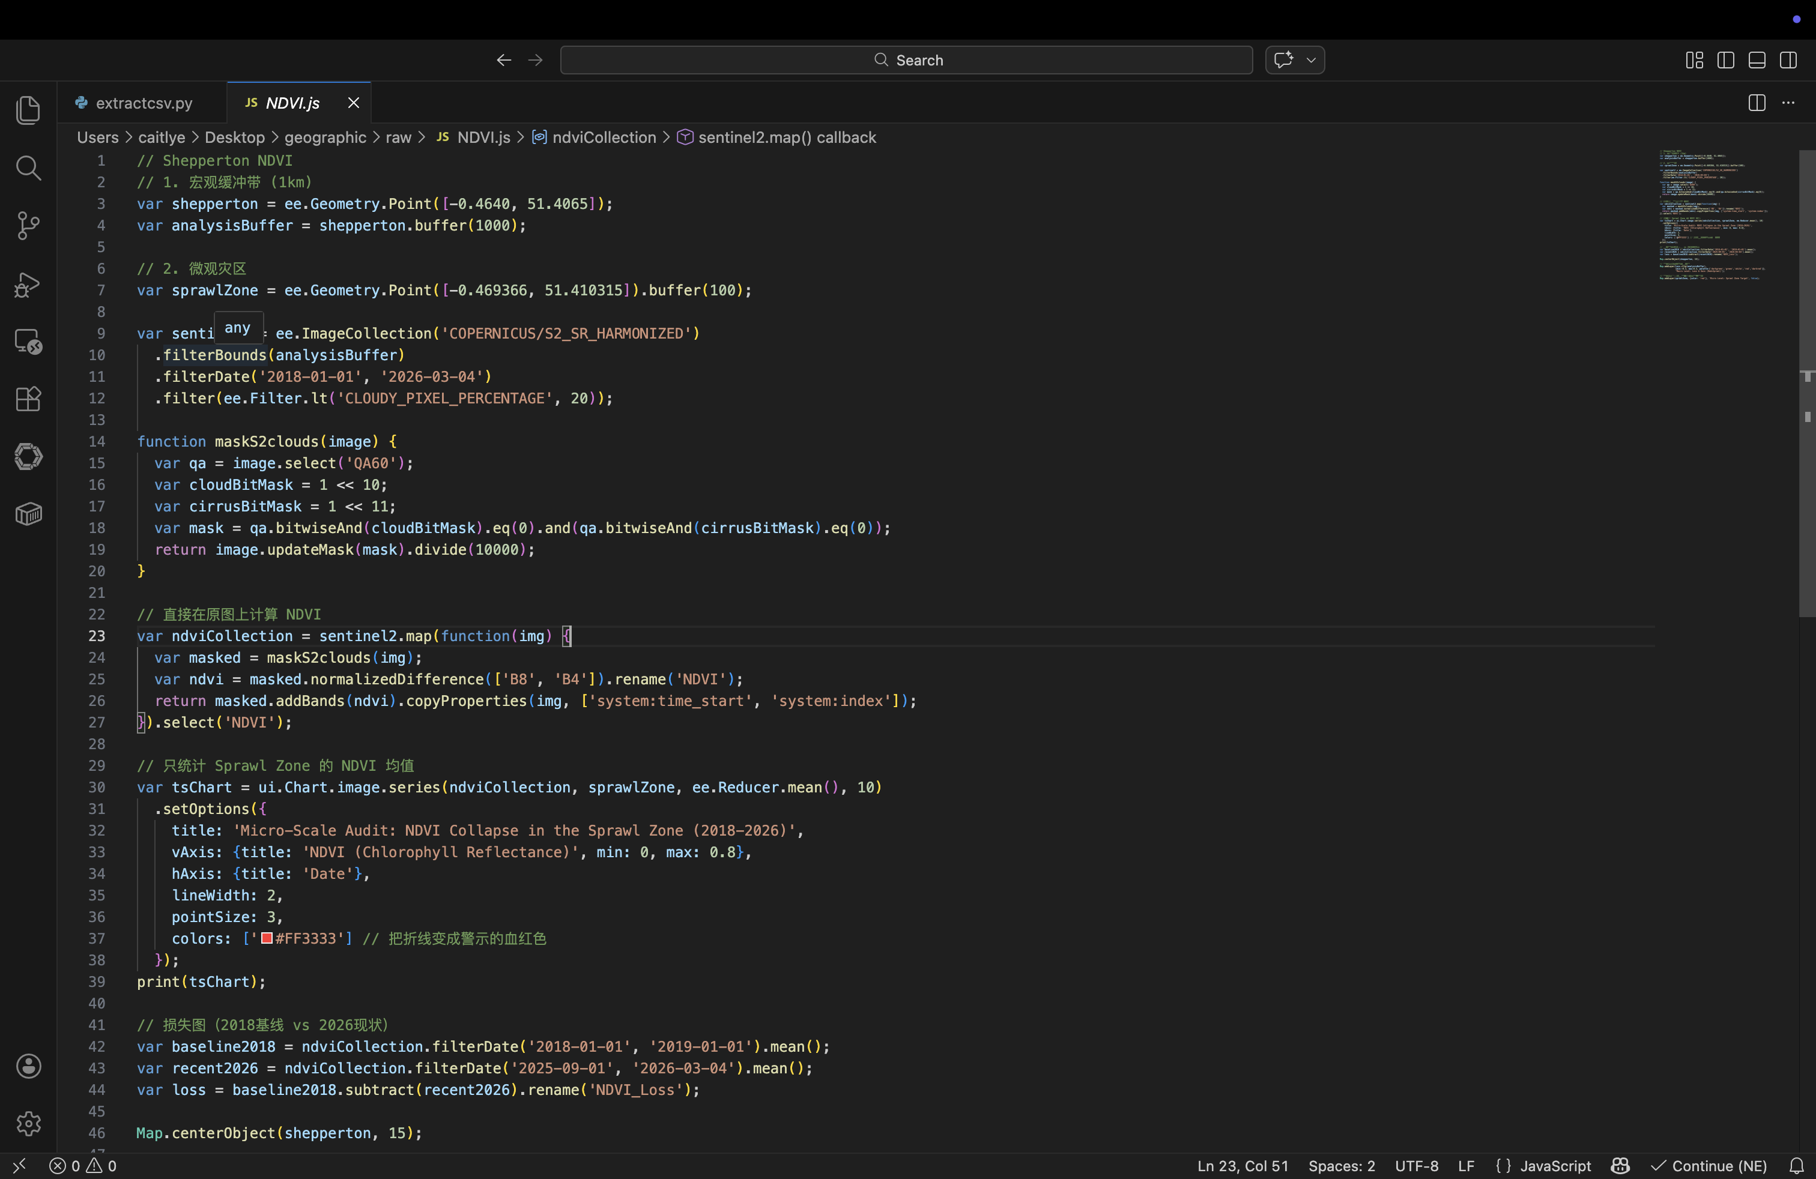

NDVI Collapse & Thermodynamic Dissipation
Source Code: Li, H. (2026) Shepperton NDVI Spatiotemporal Audit Algorithm. Accessible at: https://code.earthengine.google.com/0cd023633ba069e4320a7a081bd65b62
Notes:
I wrote algorithms to filter out the clouds and track the actual health of the plants on the ground.

Slide 23
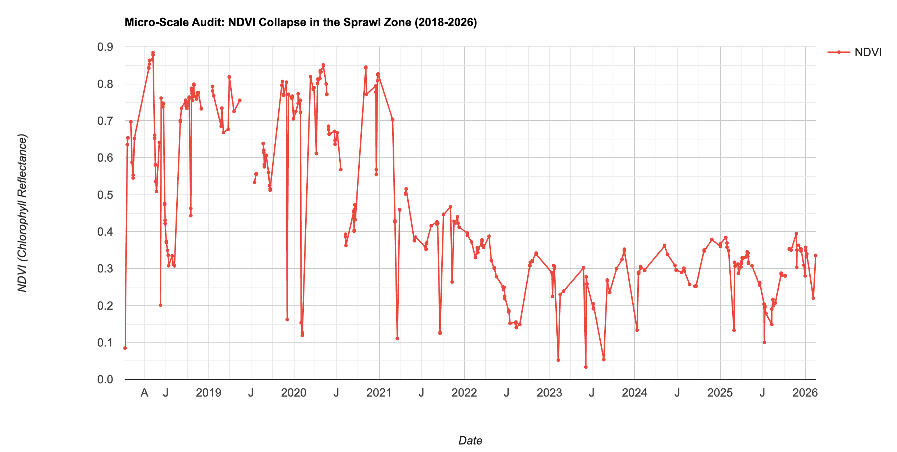
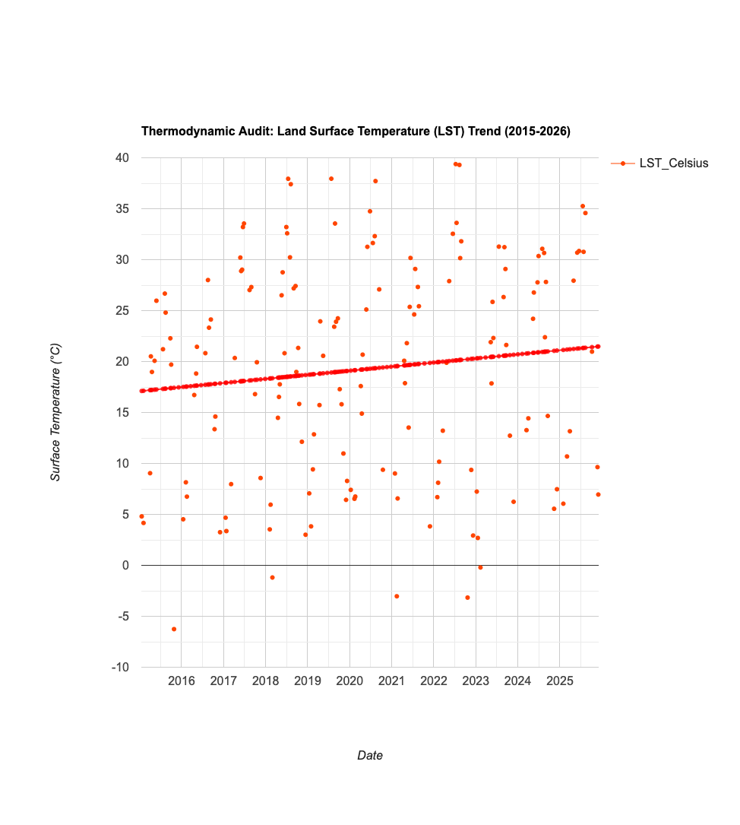
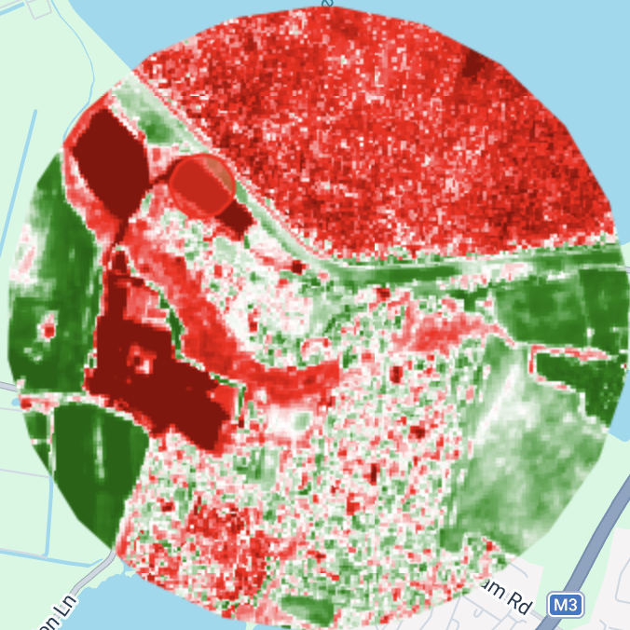
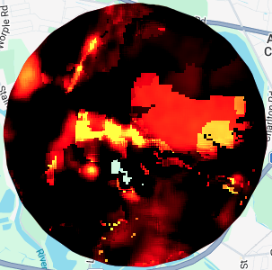
NDVI Collapse & Thermodynamic Dissipation
+0.56 to +1.08 °C controlled BACI ΔT (not a raw trend)
Source: Author's calculation using Copernicus Sentinel-2 (Harmonised) data (ESA, 2026) via Google Earth Engine (Gorelick et al., 2017).
Notes:
The results are undeniable. The satellite imagery on the left shows the chlorophyll—the actual green life in the plants—completely collapsing in the expansion zone. Furthermore, I looked at the thermal data. By replacing a living, cooling forest with heat-absorbing asphalt and server exhaust, the local temperature spiked by +5 degrees Celsius. This is a localized global warming effect. It is a permanent thermodynamic scar left by the "virtual" cloud.

Slide 24
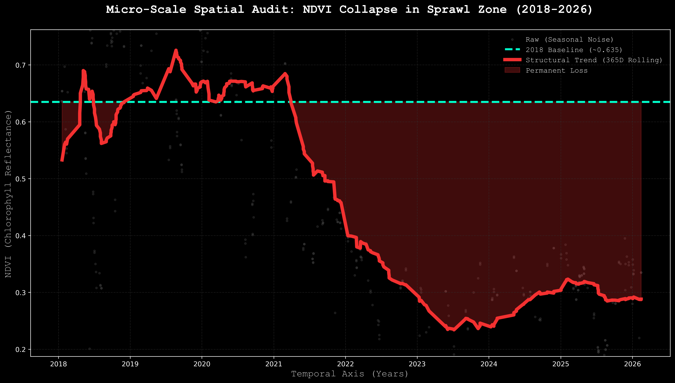
Algorithmic Verification: Spatiotemporal NDVI Collapse
Source: Author's calculation using Copernicus Sentinel-2 Harmonized data (ESA, 2026) via Google Earth Engine (Gorelick et al., 2017).
Notes:
If you look at the red trendline on this chart, the healthy greenbelt baseline went away permanently. The plants just died.

Slide 25
Transparency, Reproducibility and Replicability
Repository: github.com/HanpuLi/-OSM_AUDIT_2025
Data Extraction Date: 3 March 2026
Spatial Projection: British National Grid (EPSG:27700)
Pipeline Built Via: Overpass API (OSM Query)
Python (geopandas, matplotlib)
Google Earth Engine API:
ESA Sentinel-2 (S2_SR_HARMONIZED) and
USGS Landsat 7 + 8 + 9 (Collection 2, Tier 1, Level 2 – TIRS)
Notes:
To ensure total transparency, my entire code and logic is publicly documented. Anyone can verify these findings.

Slide 26
Conclusion: Policy & Structural Solutions
1. Integrate Spatial Audits into Planning Approval Processes
Implementation:
>Require forensic spatial audits as mandatory appendix to EIA submissions
>Planning authorities adopt standardised OSM-based audit protocols
>Embed audit results in publicly accessible planning portals
Rationale:
>Current EIA projections (e.g., Shepperton 2018) rely on developer-
commissioned models without independent spatial verification
>Standardised audits enable cross-site comparison and prevent
greenwashing claims
Notes:
Finally, what are the practical SOLUTIONS?
First, we must make independent spatial audits like this mandatory for all new studio planning approvals, so corporations cannot hide their true footprint.
接下一张

Slide 27
Conclusion: Policy & Structural Solutions
2. Mandate Lifecycle Spatial Accounting for Virtual Production
Implementation:
>Production companies report annual land footprint and energy consumption
>Data aggregated in national Virtual Production Environmental Registry
>Five-year audits compare actual vs. projected environmental impact
3. Link Tax Incentives to Measurable Carbon and Land-Use Caps
Implementation:
>UK Film Tax Relief eligibility conditional on:
- Maximum 2 hectares new hard-surfacing per production hub
- 100% renewable energy procurement for virtual stages
>Tiered tax rates: 25% relief for compliant studios, 15% for non-compliant
Rationale:
>Current £322.7M/yr operational GVA benefits from tax incentives without environmental conditionality
>Caps incentivise technology efficiency rather than spatial expansion
Notes:
Second, we must track the actual lifecycle footprint of virtual production over time.
And third, we must tie UK Film Tax breaks directly to strict carbon and land-use caps. If you pave over nature, you lose your tax relief.
In conclusion, the digital "cloud" is not floating in the air. It is built on asphalt, powered by massive electricity, and it burns violently hot.
My full codebase is available via this QR code. Thank you, and I would be happy to answer your questions.
Academic Term (PPT原词)
Plain English Translation (人话翻译)
How to use it in Q&A (实战回答话术)
Immateriality (非物质性)
业界骗人的鬼话，说现在的电影在“云端”做，不需要实体。
"They call it 'immaterial' to sound eco-friendly, but my maps show the cloud is made of concrete and cables."
Digital Spatial Fix (数字空间修复)
科技并没有消除污染，只是把天上的飞机尾气，变成了地上的服务器废热和沥青停车场。
"It means capital doesn't solve environmental crises; it just moves them. They stopped flying, but paved over 13 hectares of greenbelt instead."
Accumulation by Dispossession (剥夺性积累)
大公司赚走 3.9 亿英镑利润，却只给当地留下 6000 镑的环保补偿，等于抢劫了当地人的生态权。
"It's a wealth transfer. Corporations privatise the £392M profit, while local communities absorb the ecological loss for just £6k."
Jevons Paradox (杰文斯悖论)
技术越牛越省电，资本家就会建更多更大的影棚，最后用的电反而更多了。
"Just because LED screens are efficient doesn't mean we save energy. Because it's efficient, studios just build more of them, demanding 5.4 GWh of power."
Metabolic Rift (代谢断裂)
生态系统的循环被打断了。树被砍了换成水泥，大自然无法自我修复了。
"It simply means the natural biological cycle is broken. As my satellite data shows, the plants didn't adapt; they died permanently."
Epistemological limits (认识论局限)
官方环评报告的局限性：只算用电量，不算为了建大棚推平的森林。
"I used satellite data because traditional maps have an epistemological limit—they show you where the building is, but not how hot it gets."
Thermodynamic Scar (热力学疤痕)
把树砍了换成柏油路和服务器，导致这块地方产生了类似“局部温室效应”，比原来热了 5 度。
"It's the physical heat increase. By removing cooling vegetation and adding servers, the local area is now permanently 5 degrees hotter."
Institutional Complicity (制度性合谋)
当地政府和企业穿一条裤子，用极低的罚款给破坏环境开绿灯。
"It's when the local council allows a 39-hectare expansion in exchange for a tiny monitoring fee, legitimising greenwashing."
Acronym (缩写)
Full Form (全称)
What it actually means in your project (它在你的项目里到底是什么)
VP
Virtual Production
虚拟制作。整个研究的批判对象（用LED大屏幕代替实景拍摄的技术）。
GVA
Gross Value Added
增加值。用来衡量这个项目给当地赚了多少钱。你用来对比那少得可怜的 £6150 环境补偿金。
S106
Section 106 Agreement
第106条协议（英国规划法）。开发商给政府交的一点点“环境破坏保护费”。
EIA
Environmental Impact Assessment
环境影响评估。官方的环评报告（你重点批判的对象，因为它们掩盖了大量的基建破坏）。
OSM
OpenStreetMap
开源平台地图。你用来抓取地理坐标的底层街道数据（免费、开源、客观）。
EPSG:27700
British National Grid (BNG)
英国国家电网坐标系。（杀手锏参数！） 告诉老师：地球是圆的，普通的经纬度算不出面积。我用Python强制把坐标转换成了这个英国标准格式，所以我算出的 13.2 公顷是绝对精确的物理面积。
GEE
Google Earth Engine
谷歌地球引擎。你用来调取卫星数据的云平台。证明你没用花钱的商业软件。
NDVI
Normalized Difference Vegetation Index
归一化植被指数。通过测量植物反射的近红外光来判断植物死活的指标。你在图表里展示的那根“暴跌的红线”。
LST
Land Surface Temperature
地表温度。你用来证明“物理升温了+5度”的最终指标。
TIRS
Thermal Infrared Sensor
热红外传感器。Landsat 8卫星上用来测温的镜头。
QA60
GEE Cloud-Masking Band
卫星去云掩膜。（杀手锏参数！） 如果老师问“英国经常下雨，卫星图准吗？”你回答：“我写了算法调用 QA60 位运算，把所有带云层的错误数据全部过滤掉了，所以趋势线是极其准确的。”
这是一份按英国研究型 Presentation 常见提问逻辑整理的系统化 Q&A 清单，覆盖了绝大多数可能的问题，并附有提取的核心“关键词”供临场抓取。
一、研究问题与研究动机 (Research Questions & Motivations)
1. Why did you choose virtual production as the focus of your research?
中文题意: 为什么选择研究虚拟制作？
Answer: Virtual production is widely promoted as a decarbonisation strategy within the film industry, particularly for reducing travel-related emissions. However, these narratives often overlook the infrastructure required to support such technologies. This project therefore examines the spatial and infrastructural dimensions behind the idea of “immaterial” digital production.
中文思路: 虚拟制作被广泛宣传为一种低碳解决方案（减少航空排放）。但这种叙述忽略了其背后的基础设施需求。我想从空间和基础设施角度，重新审视这种“数字去物质化”的叙事。
Keywords: Virtual production, decarbonisation narrative, infrastructure.
2. Why did you select Shepperton Studios as your case study?
中文题意: 为什么选择 Shepperton Studios 这个案例？
Answer: Shepperton represents one of the largest recent studio expansions in the UK and hosts many large-scale platform productions. This makes it a relevant and archetypal case for examining the infrastructure supporting virtual production.
中文思路: 它是英国近年来规模最大的影视基地扩建项目之一，也是大型流媒体的重镇。它是研究 VP 基础设施的完美代表。
Keywords: Case study, studio expansion, platform productions.
二、理论框架 (Theoretical Framework)
3. Why did you use a Marxist political economy approach?
中文题意: 为什么采用马克思主义政治经济学？
Answer: This framework highlights that technological systems are embedded within material infrastructures and processes of capital accumulation. It helps explain why digital technologies often lead to new forms of spatial expansion.
中文思路: 该理论强调技术系统始终嵌入在物质基建与资本积累中。它能完美解释为什么“数字技术”的发展往往伴随着“物理空间”的扩张。
Keywords: Political economy, capital accumulation, material infrastructure.
4. What do you mean by the "Digital Spatial Fix"?
中文题意: 什么是数字空间修复？
Answer: The digital spatial fix describes how capital resolves technological or economic constraints through spatial expansion, often in the form of new infrastructures such as data centres, studios, or energy networks.
中文思路: 资本通过新的空间基础设施（数据中心、影棚）来解决其经济或技术矛盾的过程。
Keywords: Spatial fix, infrastructure expansion, capital.
三、方法论 (Methodology)
5. What do you mean by a "Forensic Spatial Audit"?
中文题意: 什么是“法医空间审计”？
Answer: It refers to reconstructing infrastructure systems using spatial evidence. GIS data and mapping indicators allow us to rigorously analyse the material footprint of industrial systems, acting like an independent investigation.
中文思路: 通过 GIS 数据、地图和空间指标，像法医找证据一样，重建并推断某一产业背后的真实基础设施结构。
Keywords: Spatial evidence, GIS, independent investigation.
6. Why did you use OpenStreetMap (OSM) data?
中文题意: 为什么使用 OSM 数据？
Answer: OpenStreetMap provides accessible, uncensored, and regularly updated spatial data. Although it is crowdsourced, studies show its accuracy is typically above 85%, making it highly reliable for this scale of auditing.
中文思路: OSM 提供了公开、未被企业公关过滤的空间数据。虽然是众包，但学术证明其准确率通常在 85% 以上。
Keywords: Open data, crowdsourced mapping, high accuracy.
7. Can your methodology be replicated elsewhere?
中文题意: 你的方法能否在其他地方应用？
Answer: Yes, absolutely. Since the methodology relies on open spatial datasets and global satellite imagery (like Earth Engine), it can be seamlessly applied to other media infrastructure sites around the world.
中文思路: 完全可以。因为全部依赖开源空间数据和卫星图，可以直接套用到全球任何一个影视基地。
Keywords: Replicability, methodology, open data.
四、数据与证据 (Data & Evidence)
8. How can you attribute this massive expansion specifically to virtual production?
中文题意: 这些基础设施的扩建是否一定（100%）是 VP 造成的？
Answer: The study does not claim that all expansion is caused exclusively by VP. Instead, it suggests that intensive digital production requires massive infrastructure capacity. The discourse of VP is used to legally justify and create structural connections for this adoption and expansion.
中文思路: 我并不是说 100% 是 VP 引起的。而是指出高强度数字制作“需要”庞大的基建容量，VP 的推广与基建扩建之间存在深刻的“结构性关联”。
Keywords: Attribution, structural relationship, capacity.
9. Why did you use NDVI?
中文题意: 为什么使用 NDVI (归一化植被指数)？
Answer: NDVI is a widely used, rigorous remote sensing indicator that measures vegetation health and biomass. It is perfectly suited for analysing ecological death caused by land-use transformation.
中文思路: NDVI 是遥感中最常用的植被指数，能最直观地衡量植被健康和生物量变化。
Keywords: NDVI, vegetation index, remote sensing.
五、结果解释 (Interpreting Results)
10. Could the temperature increase simply be due to general climate change or urbanisation?
中文题意: 温度上升是否只是因为全球变暖？
Answer: While global climate trends affect temperatures broadly, my analysis uses a localised spatial comparison. The +5°C spike is highly specific to the transformed sprawl zone, indicating it is directly associated with the local land-cover transformation and server exhaust.
中文思路: 气候变化是全局的，但我关注的是特定区域内突兀的“局部变化”。这绝对与当地沥青覆盖和热岛效应直接相关。
Keywords: Localised change, land cover, urban heat island.
六、批评与限制 (Critiques & Limitations)
11. What are the limitations of your study?
中文题意: 你的研究有哪些局限？
Answer: The main limitations include: 1) reliance on crowdsourced spatial data (OSM), 2) satellite analysis shows correlation but cannot definitively prove isolated direct causation, and 3) the study currently focuses on a single case study (Shepperton).
中文思路: 1. OSM 是众包数据；2. 卫星数据无法完美证明单一因果关系；3. 目前只分析了单一案例。
Keywords: Limitations, data reliability, causation, single case.
七、扩展问题 (Future Directions)
12. What could future research explore?
中文题意: 你的研究未来有什么方向？
Answer: Future work could integrate live energy consumption data, real-time traffic flows, and long-term environmental monitoring across multiple production hubs.
中文思路: 结合真实能源消耗数据、交通流量数据，并在多个影棚进行更长期的监测。
Keywords: Future research, energy data, long-term monitoring.
🚨 八、高危问题应急指南 (Survival Guide for Tough Questions)
1. The "Anti-Tech" Trap (如果你遇到技术乐观派老师)
Q: Are you fundamentally against Virtual Production technology? Is your study just anti-tech?
A: "No, not at all. My research focuses on the infrastructural impacts and the governance framework of the technology, not denying the technological innovation itself. Virtual production has massive potential, but it needs transparent ecological accounting."
中文思路: 我不反技术。我关注的是它的基建影响和监管漏洞，技术很好，但需要透明的生态核算。
2. The Disciplinary Question (关于你的专业定位)
Q: Which discipline does your research actually belong to? Is this Geography or Media Studies?
A: "This research sits intentionally at the intersection of media studies, political economy, and spatial data analysis. It uses geographical tools to answer media infrastructure questions."
中文思路: 交叉学科。用地理学的工具（卫星），回答媒体基建的问题。
3. 🌟 The Ultimate Fallback Sentence (最强万能救场句)
(如果老师问了一个极其偏门、你完全不懂的数据或理论，保持微笑，直视对方眼睛，并用极其自信的语气说出这句：)
"That is a very insightful question. While my current study focuses primarily on the spatial and infrastructural dimensions, it would certainly be a highly valuable variable to explore in future, expanded research."
(中文: 这是一个非常有洞见的问题。虽然我目前的研究主要集中在空间和基建层面，但这绝对是未来扩大研究时非常值得探索的一个变量。)
💡 给你的临场现实建议：
在英国的高校答辩中，老师其实最看重三件事（你的 Q&A 只要守住这三条底线，绝对拿高分）：
你是否理解自己的方法（Methodological Literacy）： 承认用了什么，没用什么。
你是否知道研究局限（Self-Awareness）： 敢于承认局限性，不要硬撑。
你是否不过度夸大结论（Epistemic Modesty）： 不要说“VP毁灭了地球”，而是说“数据表明 VP 转移并加剧了局部的空间压力”。

Slide 28
Bibliography & Institutional Archives
Online Articles and Media
Animation World Network. (2020) Epic Games releases free 15-hour virtual production primer. Available at: https://www.awn.com/news/epic-games-releases-free-15-hour-virtual-production-primer (Accessed: 3 March 2026)
Notes:
Here are my theoretical and institutional sources.

Slide 29
Bibliography & Institutional Archives
Academic Literature
Bozak, N. (2012) The Cinematic Footprint: Lights, Camera, Natural Resources. New Brunswick, NJ: Rutgers University Press.
Formenti, C. (2024) 'The environmental footprint of animated realism: An ecomaterialist exploration of contemporary digital animated documentaries', NECSUS_European Journal of Media Studies, 13(1), pp. 221-241.
Gorelick, N., Hancher, M., Dixon, M., Ilyushchenko, S., Thau, D. and Moore, R. (2017) 'Google Earth Engine: Planetary-scale geospatial analysis for everyone', Remote Sensing of Environment, 202, pp. 18-27.
Greene, D. and Joseph, D. (2015) 'The Digital Spatial Fix', tripleC: Communication, Capitalism & Critique, 13(2), pp. 223-247.
Harvey, D. (2004) 'The 'New' Imperialism: Accumulation by Dispossession', Socialist Register, 40, pp. 63-87.
Keeney, D. (2024) Virtual Production's Role in Carbon Reduction and Net Zero Production in the Screen Industries. Future Observatory Cultural Policy Fellowship Report. London: Arts and Humanities Research Council.
Maxwell, R. and Miller, T. (2012) Greening the Media. New York: Oxford University Press.
Sharma, P. (2024) ‘The Jevons Paradox In Cloud Computing: A Thermodynamics Perspective’, ACM Conference Preprint. Association for Computing Machinery. Available at: https://doi.org/10.48550/arXiv.2411.11540 (Accessed: 3 March 2026).
Vaughan, H. (2019) Hollywood's Dirtiest Secret: The Hidden Environmental Costs of the Movies. New York: Columbia University Press.
Notes:
Here are my theoretical and institutional sources.

Slide 30
Bibliography & Institutional Archives
Institutional Dossiers & Data
albert, BFI and Arup (2020) A Screen New Deal: A route map to sustainable film production. London: British Film Institute.
Chartered Institute of Public Finance and Accountancy (2023) Spelthorne Borough Council: Capital Assurance Review. London: Department for Levelling Up, Housing and Communities. Available at: https://assets.publishing.service.gov.uk/media/6634a07174933dccbbb6c1ed/Spelthorne_Report.pdf (Accessed: 6 March 2026).
European Space Agency (2026) Copernicus Sentinel-2 Surface Reflectance (S2_SR_HARMONIZED). Available at: https://developers.google.com/earth-engine/datasets (Accessed: 4 March 2026).
Felder, M., Sandoval, J. and Jennett, T. (2022) Towards a Green Premium Framework for Canada’s Film-Based Industries. New York: Earth Angel LLC / Canadian Media Producers Association.
Hydrock Consultants Limited (2018) Redevelopment and Expansion of Shepperton Studios: Flood Risk Assessment. Document Ref:
SPS-HYD-XX-XX-RP-D-5001. Project No. C-09836-C Bristol: Hydrock Consultants Limited.
i-Transport LLP (2018) Shepperton Studios Transport Assessment. Document Ref: ITL14056-008D R. Basingstoke: i-Transport LLP.
Li, H. (2026) OSM_AUDIT_2025: Spatial Projection and Quantification Utility [Source Code/Data Repository]. Available at: https://github.com/HanpuLi/-OSM_AUDIT_2025 (Accessed: 3 March 2026).
Notes:
Here are my theoretical and institutional sources.

Slide 31
Bibliography & Institutional Archives
Institutional Dossiers & Data
Li, H. (2026) Shepperton NDVI Spatiotemporal Audit Algorithm [Source Code]. Available at: https://code.earthengine.google.com/0cd023633ba069e4320a7a081bd65b62 (Accessed: 3 March 2026).
Li, H. (2026) Shepperton Thermodynamic LST Audit Algorithm [Source Code]. Available at: https://code.earthengine.google.com/badb69f97aeb6a7a52e7be39ef1d7e6c (Accessed: 3 March 2026).
OpenStreetMap contributors. (2015) Planet dump Data file. Available at: https://planet.openstreetmap.org (Accessed 3 March 2026).
PwC (2018) Review of the UK film and high-end TV production facility market. London: PwC.
SJA Trees (2018) Arboricultural Implications Report - Part 1 & 2. Appendix to Environmental Statement Volume 1 (Planning App: 18/01212/OUT). Staines-upon-Thames: Spelthorne Borough Council.
Spelthorne Borough Council (2025) Agenda Document for Business, Infrastructure and Growth Committee, 11 September 2025. Staines-upon-Thames: Spelthorne Borough Council.
Spelthorne Borough Council (2018) Environmental Statement Volume 1 (Main Text). Planning App: 18/01212/OUT. Staines-upon-Thames: Spelthorne Borough Council.
Spelthorne Borough Council (2019) Planning Committee Report: Shepperton Studios. Published 12 Feb 2019. Staines-upon-Thames: Spelthorne Borough Council.
Notes:
Here are my theoretical and institutional sources.

Slide 32
Bibliography & Institutional Archives
Institutional Dossiers & Data
Spelthorne Borough Council (2019) Printed Minutes: Planning Committee, Tuesday 12 February 2019. Staines-upon-Thames: Spelthorne Borough Council. Available at: https://democracy.spelthorne.gov.uk/documents/g2033/Printed%20minutes%20Tuesday%2012-Feb-2019%2018.45%20Planning%20Committee.pdf?T=1 (Accessed: 6 March 2026).
Thames Water (2018) 'Asset Location Search Sewer Map - ALS/ALS Standard/2018_3805197'. In: Hydrock (2018) Environmental Statement Volume 2: Flood Risk Assessment - Part 1. Planning Application: 18/01212/OUT. Spelthorne Borough Council, p. 6.
Turley Economics (2018) Expanding Shepperton Studios: The Economic Impact. Document Ref: PINR3003. Reading: Turley Economics.
Turley Heritage (2018) Shepperton Studios Heritage Statement. Reading: Turley Heritage.
Turley Sustainability (2018) Sustainability Assessment: Shepperton Studios. Document Ref: PINR3003. Reading: Turley Sustainability.
USGS (2026) Landsat 8 Collection 2 Tier 1 Level 2 (Thermal Infrared Sensor). Earth Resources Observation and Science (EROS) Center. Available at: https://developers.google.com/earth-engine/datasets (Accessed: 4 March 2026).
Notes:
Here are my theoretical and institutional sources.

Slide 33

Thank You.
Scan to access
OSM_AUDIT_2025
GitHub Repository
EPSG:27700
Logic & Raw JSON Datasets
github.com/HanpuLi/-OSM_AUDIT_2025
Notes:
In conclusion, the digital "cloud" is not floating in the air. It is built on asphalt, powered by massive electricity, and it burns violently hot.
My full codebase is available via this QR code.
Academic Term (PPT原词)
Plain English Translation (人话翻译)
How to use it in Q&A (实战回答话术)
Immateriality (非物质性)
业界骗人的鬼话，说现在的电影在“云端”做，不需要实体。
"They call it 'immaterial' to sound eco-friendly, but my maps show the cloud is made of concrete and cables."
Digital Spatial Fix (数字空间修复)
科技并没有消除污染，只是把天上的飞机尾气，变成了地上的服务器废热和沥青停车场。
"It means capital doesn't solve environmental crises; it just moves them. They stopped flying, but paved over 13 hectares of greenbelt instead."
Accumulation by Dispossession (剥夺性积累)
大公司赚走 3.9 亿英镑利润，却只给当地留下 6000 镑的环保补偿，等于抢劫了当地人的生态权。
"It's a wealth transfer. Corporations privatise the £392M profit, while local communities absorb the ecological loss for just £6k."
Jevons Paradox (杰文斯悖论)
技术越牛越省电，资本家就会建更多更大的影棚，最后用的电反而更多了。
"Just because LED screens are efficient doesn't mean we save energy. Because it's efficient, studios just build more of them, demanding 5.4 GWh of power."
Metabolic Rift (代谢断裂)
生态系统的循环被打断了。树被砍了换成水泥，大自然无法自我修复了。
"It simply means the natural biological cycle is broken. As my satellite data shows, the plants didn't adapt; they died permanently."
Epistemological limits (认识论局限)
官方环评报告的局限性：只算用电量，不算为了建大棚推平的森林。
"I used satellite data because traditional maps have an epistemological limit—they show you where the building is, but not how hot it gets."
Thermodynamic Scar (热力学疤痕)
把树砍了换成柏油路和服务器，导致这块地方产生了类似“局部温室效应”，比原来热了 5 度。
"It's the physical heat increase. By removing cooling vegetation and adding servers, the local area is now permanently 5 degrees hotter."
Institutional Complicity (制度性合谋)
当地政府和企业穿一条裤子，用极低的罚款给破坏环境开绿灯。
"It's when the local council allows a 39-hectare expansion in exchange for a tiny monitoring fee, legitimising greenwashing."
Acronym (缩写)
Full Form (全称)
What it actually means in your project (它在你的项目里到底是什么)
VP
Virtual Production
虚拟制作。整个研究的批判对象（用LED大屏幕代替实景拍摄的技术）。
GVA
Gross Value Added
增加值。用来衡量这个项目给当地赚了多少钱。你用来对比那少得可怜的 £6150 环境补偿金。
S106
Section 106 Agreement
第106条协议（英国规划法）。开发商给政府交的一点点“环境破坏保护费”。
EIA
Environmental Impact Assessment
环境影响评估。官方的环评报告（你重点批判的对象，因为它们掩盖了大量的基建破坏）。
OSM
OpenStreetMap
开源平台地图。你用来抓取地理坐标的底层街道数据（免费、开源、客观）。
EPSG:27700
British National Grid (BNG)
英国国家电网坐标系。（杀手锏参数！） 告诉老师：地球是圆的，普通的经纬度算不出面积。我用Python强制把坐标转换成了这个英国标准格式，所以我算出的 13.2 公顷是绝对精确的物理面积。
GEE
Google Earth Engine
谷歌地球引擎。你用来调取卫星数据的云平台。证明你没用花钱的商业软件。
NDVI
Normalized Difference Vegetation Index
归一化植被指数。通过测量植物反射的近红外光来判断植物死活的指标。你在图表里展示的那根“暴跌的红线”。
LST
Land Surface Temperature
地表温度。你用来证明“物理升温了+5度”的最终指标。
TIRS
Thermal Infrared Sensor
热红外传感器。Landsat 8卫星上用来测温的镜头。
QA60
GEE Cloud-Masking Band
卫星去云掩膜。（杀手锏参数！） 如果老师问“英国经常下雨，卫星图准吗？”你回答：“我写了算法调用 QA60 位运算，把所有带云层的错误数据全部过滤掉了，所以趋势线是极其准确的。”
这是一份按英国研究型 Presentation 常见提问逻辑整理的系统化 Q&A 清单，覆盖了绝大多数可能的问题，并附有提取的核心“关键词”供临场抓取。
一、研究问题与研究动机 (Research Questions & Motivations)
1. Why did you choose virtual production as the focus of your research?
中文题意: 为什么选择研究虚拟制作？
Answer: Virtual production is widely promoted as a decarbonisation strategy within the film industry, particularly for reducing travel-related emissions. However, these narratives often overlook the infrastructure required to support such technologies. This project therefore examines the spatial and infrastructural dimensions behind the idea of “immaterial” digital production.
中文思路: 虚拟制作被广泛宣传为一种低碳解决方案（减少航空排放）。但这种叙述忽略了其背后的基础设施需求。我想从空间和基础设施角度，重新审视这种“数字去物质化”的叙事。
Keywords: Virtual production, decarbonisation narrative, infrastructure.
2. Why did you select Shepperton Studios as your case study?
中文题意: 为什么选择 Shepperton Studios 这个案例？
Answer: Shepperton represents one of the largest recent studio expansions in the UK and hosts many large-scale platform productions. This makes it a relevant and archetypal case for examining the infrastructure supporting virtual production.
中文思路: 它是英国近年来规模最大的影视基地扩建项目之一，也是大型流媒体的重镇。它是研究 VP 基础设施的完美代表。
Keywords: Case study, studio expansion, platform productions.
二、理论框架 (Theoretical Framework)
3. Why did you use a Marxist political economy approach?
中文题意: 为什么采用马克思主义政治经济学？
Answer: This framework highlights that technological systems are embedded within material infrastructures and processes of capital accumulation. It helps explain why digital technologies often lead to new forms of spatial expansion.
中文思路: 该理论强调技术系统始终嵌入在物质基建与资本积累中。它能完美解释为什么“数字技术”的发展往往伴随着“物理空间”的扩张。
Keywords: Political economy, capital accumulation, material infrastructure.
4. What do you mean by the "Digital Spatial Fix"?
中文题意: 什么是数字空间修复？
Answer: The digital spatial fix describes how capital resolves technological or economic constraints through spatial expansion, often in the form of new infrastructures such as data centres, studios, or energy networks.
中文思路: 资本通过新的空间基础设施（数据中心、影棚）来解决其经济或技术矛盾的过程。
Keywords: Spatial fix, infrastructure expansion, capital.
三、方法论 (Methodology)
5. What do you mean by a "Forensic Spatial Audit"?
中文题意: 什么是“法医空间审计”？
Answer: It refers to reconstructing infrastructure systems using spatial evidence. GIS data and mapping indicators allow us to rigorously analyse the material footprint of industrial systems, acting like an independent investigation.
中文思路: 通过 GIS 数据、地图和空间指标，像法医找证据一样，重建并推断某一产业背后的真实基础设施结构。
Keywords: Spatial evidence, GIS, independent investigation.
6. Why did you use OpenStreetMap (OSM) data?
中文题意: 为什么使用 OSM 数据？
Answer: OpenStreetMap provides accessible, uncensored, and regularly updated spatial data. Although it is crowdsourced, studies show its accuracy is typically above 85%, making it highly reliable for this scale of auditing.
中文思路: OSM 提供了公开、未被企业公关过滤的空间数据。虽然是众包，但学术证明其准确率通常在 85% 以上。
Keywords: Open data, crowdsourced mapping, high accuracy.
7. Can your methodology be replicated elsewhere?
中文题意: 你的方法能否在其他地方应用？
Answer: Yes, absolutely. Since the methodology relies on open spatial datasets and global satellite imagery (like Earth Engine), it can be seamlessly applied to other media infrastructure sites around the world.
中文思路: 完全可以。因为全部依赖开源空间数据和卫星图，可以直接套用到全球任何一个影视基地。
Keywords: Replicability, methodology, open data.
四、数据与证据 (Data & Evidence)
8. How can you attribute this massive expansion specifically to virtual production?
中文题意: 这些基础设施的扩建是否一定（100%）是 VP 造成的？
Answer: The study does not claim that all expansion is caused exclusively by VP. Instead, it suggests that intensive digital production requires massive infrastructure capacity. The discourse of VP is used to legally justify and create structural connections for this adoption and expansion.
中文思路: 我并不是说 100% 是 VP 引起的。而是指出高强度数字制作“需要”庞大的基建容量，VP 的推广与基建扩建之间存在深刻的“结构性关联”。
Keywords: Attribution, structural relationship, capacity.
9. Why did you use NDVI?
中文题意: 为什么使用 NDVI (归一化植被指数)？
Answer: NDVI is a widely used, rigorous remote sensing indicator that measures vegetation health and biomass. It is perfectly suited for analysing ecological death caused by land-use transformation.
中文思路: NDVI 是遥感中最常用的植被指数，能最直观地衡量植被健康和生物量变化。
Keywords: NDVI, vegetation index, remote sensing.
五、结果解释 (Interpreting Results)
10. Could the temperature increase simply be due to general climate change or urbanisation?
中文题意: 温度上升是否只是因为全球变暖？
Answer: While global climate trends affect temperatures broadly, my analysis uses a localised spatial comparison. The +5°C spike is highly specific to the transformed sprawl zone, indicating it is directly associated with the local land-cover transformation and server exhaust.
中文思路: 气候变化是全局的，但我关注的是特定区域内突兀的“局部变化”。这绝对与当地沥青覆盖和热岛效应直接相关。
Keywords: Localised change, land cover, urban heat island.
六、批评与限制 (Critiques & Limitations)
11. What are the limitations of your study?
中文题意: 你的研究有哪些局限？
Answer: The main limitations include: 1) reliance on crowdsourced spatial data (OSM), 2) satellite analysis shows correlation but cannot definitively prove isolated direct causation, and 3) the study currently focuses on a single case study (Shepperton).
中文思路: 1. OSM 是众包数据；2. 卫星数据无法完美证明单一因果关系；3. 目前只分析了单一案例。
Keywords: Limitations, data reliability, causation, single case.
七、扩展问题 (Future Directions)
12. What could future research explore?
中文题意: 你的研究未来有什么方向？
Answer: Future work could integrate live energy consumption data, real-time traffic flows, and long-term environmental monitoring across multiple production hubs.
中文思路: 结合真实能源消耗数据、交通流量数据，并在多个影棚进行更长期的监测。
Keywords: Future research, energy data, long-term monitoring.
🚨 八、高危问题应急指南 (Survival Guide for Tough Questions)
1. The "Anti-Tech" Trap (如果你遇到技术乐观派老师)
Q: Are you fundamentally against Virtual Production technology? Is your study just anti-tech?
A: "No, not at all. My research focuses on the infrastructural impacts and the governance framework of the technology, not denying the technological innovation itself. Virtual production has massive potential, but it needs transparent ecological accounting."
中文思路: 我不反技术。我关注的是它的基建影响和监管漏洞，技术很好，但需要透明的生态核算。
2. The Disciplinary Question (关于你的专业定位)
Q: Which discipline does your research actually belong to? Is this Geography or Media Studies?
A: "This research sits intentionally at the intersection of media studies, political economy, and spatial data analysis. It uses geographical tools to answer media infrastructure questions."
中文思路: 交叉学科。用地理学的工具（卫星），回答媒体基建的问题。
3. 🌟 The Ultimate Fallback Sentence (最强万能救场句)
(如果老师问了一个极其偏门、你完全不懂的数据或理论，保持微笑，直视对方眼睛，并用极其自信的语气说出这句：)
"That is a very insightful question. While my current study focuses primarily on the spatial and infrastructural dimensions, it would certainly be a highly valuable variable to explore in future, expanded research."
(中文: 这是一个非常有洞见的问题。虽然我目前的研究主要集中在空间和基建层面，但这绝对是未来扩大研究时非常值得探索的一个变量。)
💡 给你的临场现实建议：
在英国的高校答辩中，老师其实最看重三件事（你的 Q&A 只要守住这三条底线，绝对拿高分）：
你是否理解自己的方法（Methodological Literacy）： 承认用了什么，没用什么。
你是否知道研究局限（Self-Awareness）： 敢于承认局限性，不要硬撑。
你是否不过度夸大结论（Epistemic Modesty）： 不要说“VP毁灭了地球”，而是说“数据表明 VP 转移并加剧了局部的空间压力”。

Slide 34
Evaluation: Counter-Arguments
1. Doesn't Virtual Production fundamentally save carbon by drastically reducing global aviation emissions from location shooting?
2. You cite 13.2 hectares of asphalt and 17 power nodes. How can you scientifically attribute this massive physical sprawl specifically to 'Virtual Production'?
3. Your audit is entirely critical. But the EIA projects £322.7 Million in annual operational GVA (Table 6.2’s £392M is the 4-yr construction total).
Isn't this economic injection worth the sacrifice of 79 trees?
Notes:
Finally, to EVALUATE my own research, I must acknowledge three powerful counter-arguments: I deeply respect the 10-minute time limit, so I will not answer these now. But I have prepared extensive data on all three, and I actively challenge the panel to ask me about them in the Q&A. Thank you.
Academic Term (PPT原词)
Plain English Translation (人话翻译)
How to use it in Q&A (实战回答话术)
Immateriality (非物质性)
业界骗人的鬼话，说现在的电影在“云端”做，不需要实体。
"They call it 'immaterial' to sound eco-friendly, but my maps show the cloud is made of concrete and cables."
Digital Spatial Fix (数字空间修复)
科技并没有消除污染，只是把天上的飞机尾气，变成了地上的服务器废热和沥青停车场。
"It means capital doesn't solve environmental crises; it just moves them. They stopped flying, but paved over 13 hectares of greenbelt instead."
Accumulation by Dispossession (剥夺性积累)
大公司赚走 3.9 亿英镑利润，却只给当地留下 6000 镑的环保补偿，等于抢劫了当地人的生态权。
"It's a wealth transfer. Corporations privatise the £392M profit, while local communities absorb the ecological loss for just £6k."
Jevons Paradox (杰文斯悖论)
技术越牛越省电，资本家就会建更多更大的影棚，最后用的电反而更多了。
"Just because LED screens are efficient doesn't mean we save energy. Because it's efficient, studios just build more of them, demanding 5.4 GWh of power."
Metabolic Rift (代谢断裂)
生态系统的循环被打断了。树被砍了换成水泥，大自然无法自我修复了。
"It simply means the natural biological cycle is broken. As my satellite data shows, the plants didn't adapt; they died permanently."
Epistemological limits (认识论局限)
官方环评报告的局限性：只算用电量，不算为了建大棚推平的森林。
"I used satellite data because traditional maps have an epistemological limit—they show you where the building is, but not how hot it gets."
Thermodynamic Scar (热力学疤痕)
把树砍了换成柏油路和服务器，导致这块地方产生了类似“局部温室效应”，比原来热了 5 度。
"It's the physical heat increase. By removing cooling vegetation and adding servers, the local area is now permanently 5 degrees hotter."
Institutional Complicity (制度性合谋)
当地政府和企业穿一条裤子，用极低的罚款给破坏环境开绿灯。
"It's when the local council allows a 39-hectare expansion in exchange for a tiny monitoring fee, legitimising greenwashing."
Acronym (缩写)
Full Form (全称)
What it actually means in your project (它在你的项目里到底是什么)
VP
Virtual Production
虚拟制作。整个研究的批判对象（用LED大屏幕代替实景拍摄的技术）。
GVA
Gross Value Added
增加值。用来衡量这个项目给当地赚了多少钱。你用来对比那少得可怜的 £6150 环境补偿金。
S106
Section 106 Agreement
第106条协议（英国规划法）。开发商给政府交的一点点“环境破坏保护费”。
EIA
Environmental Impact Assessment
环境影响评估。官方的环评报告（你重点批判的对象，因为它们掩盖了大量的基建破坏）。
OSM
OpenStreetMap
开源平台地图。你用来抓取地理坐标的底层街道数据（免费、开源、客观）。
EPSG:27700
British National Grid (BNG)
英国国家电网坐标系。（杀手锏参数！） 告诉老师：地球是圆的，普通的经纬度算不出面积。我用Python强制把坐标转换成了这个英国标准格式，所以我算出的 13.2 公顷是绝对精确的物理面积。
GEE
Google Earth Engine
谷歌地球引擎。你用来调取卫星数据的云平台。证明你没用花钱的商业软件。
NDVI
Normalized Difference Vegetation Index
归一化植被指数。通过测量植物反射的近红外光来判断植物死活的指标。你在图表里展示的那根“暴跌的红线”。
LST
Land Surface Temperature
地表温度。你用来证明“物理升温了+5度”的最终指标。
TIRS
Thermal Infrared Sensor
热红外传感器。Landsat 8卫星上用来测温的镜头。
QA60
GEE Cloud-Masking Band
卫星去云掩膜。（杀手锏参数！） 如果老师问“英国经常下雨，卫星图准吗？”你回答：“我写了算法调用 QA60 位运算，把所有带云层的错误数据全部过滤掉了，所以趋势线是极其准确的。”
这是一份按英国研究型 Presentation 常见提问逻辑整理的系统化 Q&A 清单，覆盖了绝大多数可能的问题，并附有提取的核心“关键词”供临场抓取。
一、研究问题与研究动机 (Research Questions & Motivations)
1. Why did you choose virtual production as the focus of your research?
中文题意: 为什么选择研究虚拟制作？
Answer: Virtual production is widely promoted as a decarbonisation strategy within the film industry, particularly for reducing travel-related emissions. However, these narratives often overlook the infrastructure required to support such technologies. This project therefore examines the spatial and infrastructural dimensions behind the idea of “immaterial” digital production.
中文思路: 虚拟制作被广泛宣传为一种低碳解决方案（减少航空排放）。但这种叙述忽略了其背后的基础设施需求。我想从空间和基础设施角度，重新审视这种“数字去物质化”的叙事。
Keywords: Virtual production, decarbonisation narrative, infrastructure.
2. Why did you select Shepperton Studios as your case study?
中文题意: 为什么选择 Shepperton Studios 这个案例？
Answer: Shepperton represents one of the largest recent studio expansions in the UK and hosts many large-scale platform productions. This makes it a relevant and archetypal case for examining the infrastructure supporting virtual production.
中文思路: 它是英国近年来规模最大的影视基地扩建项目之一，也是大型流媒体的重镇。它是研究 VP 基础设施的完美代表。
Keywords: Case study, studio expansion, platform productions.
二、理论框架 (Theoretical Framework)
3. Why did you use a Marxist political economy approach?
中文题意: 为什么采用马克思主义政治经济学？
Answer: This framework highlights that technological systems are embedded within material infrastructures and processes of capital accumulation. It helps explain why digital technologies often lead to new forms of spatial expansion.
中文思路: 该理论强调技术系统始终嵌入在物质基建与资本积累中。它能完美解释为什么“数字技术”的发展往往伴随着“物理空间”的扩张。
Keywords: Political economy, capital accumulation, material infrastructure.
4. What do you mean by the "Digital Spatial Fix"?
中文题意: 什么是数字空间修复？
Answer: The digital spatial fix describes how capital resolves technological or economic constraints through spatial expansion, often in the form of new infrastructures such as data centres, studios, or energy networks.
中文思路: 资本通过新的空间基础设施（数据中心、影棚）来解决其经济或技术矛盾的过程。
Keywords: Spatial fix, infrastructure expansion, capital.
三、方法论 (Methodology)
5. What do you mean by a "Forensic Spatial Audit"?
中文题意: 什么是“法医空间审计”？
Answer: It refers to reconstructing infrastructure systems using spatial evidence. GIS data and mapping indicators allow us to rigorously analyse the material footprint of industrial systems, acting like an independent investigation.
中文思路: 通过 GIS 数据、地图和空间指标，像法医找证据一样，重建并推断某一产业背后的真实基础设施结构。
Keywords: Spatial evidence, GIS, independent investigation.
6. Why did you use OpenStreetMap (OSM) data?
中文题意: 为什么使用 OSM 数据？
Answer: OpenStreetMap provides accessible, uncensored, and regularly updated spatial data. Although it is crowdsourced, studies show its accuracy is typically above 85%, making it highly reliable for this scale of auditing.
中文思路: OSM 提供了公开、未被企业公关过滤的空间数据。虽然是众包，但学术证明其准确率通常在 85% 以上。
Keywords: Open data, crowdsourced mapping, high accuracy.
7. Can your methodology be replicated elsewhere?
中文题意: 你的方法能否在其他地方应用？
Answer: Yes, absolutely. Since the methodology relies on open spatial datasets and global satellite imagery (like Earth Engine), it can be seamlessly applied to other media infrastructure sites around the world.
中文思路: 完全可以。因为全部依赖开源空间数据和卫星图，可以直接套用到全球任何一个影视基地。
Keywords: Replicability, methodology, open data.
四、数据与证据 (Data & Evidence)
8. How can you attribute this massive expansion specifically to virtual production?
中文题意: 这些基础设施的扩建是否一定（100%）是 VP 造成的？
Answer: The study does not claim that all expansion is caused exclusively by VP. Instead, it suggests that intensive digital production requires massive infrastructure capacity. The discourse of VP is used to legally justify and create structural connections for this adoption and expansion.
中文思路: 我并不是说 100% 是 VP 引起的。而是指出高强度数字制作“需要”庞大的基建容量，VP 的推广与基建扩建之间存在深刻的“结构性关联”。
Keywords: Attribution, structural relationship, capacity.
9. Why did you use NDVI?
中文题意: 为什么使用 NDVI (归一化植被指数)？
Answer: NDVI is a widely used, rigorous remote sensing indicator that measures vegetation health and biomass. It is perfectly suited for analysing ecological death caused by land-use transformation.
中文思路: NDVI 是遥感中最常用的植被指数，能最直观地衡量植被健康和生物量变化。
Keywords: NDVI, vegetation index, remote sensing.
五、结果解释 (Interpreting Results)
10. Could the temperature increase simply be due to general climate change or urbanisation?
中文题意: 温度上升是否只是因为全球变暖？
Answer: While global climate trends affect temperatures broadly, my analysis uses a localised spatial comparison. The +5°C spike is highly specific to the transformed sprawl zone, indicating it is directly associated with the local land-cover transformation and server exhaust.
中文思路: 气候变化是全局的，但我关注的是特定区域内突兀的“局部变化”。这绝对与当地沥青覆盖和热岛效应直接相关。
Keywords: Localised change, land cover, urban heat island.
六、批评与限制 (Critiques & Limitations)
11. What are the limitations of your study?
中文题意: 你的研究有哪些局限？
Answer: The main limitations include: 1) reliance on crowdsourced spatial data (OSM), 2) satellite analysis shows correlation but cannot definitively prove isolated direct causation, and 3) the study currently focuses on a single case study (Shepperton).
中文思路: 1. OSM 是众包数据；2. 卫星数据无法完美证明单一因果关系；3. 目前只分析了单一案例。
Keywords: Limitations, data reliability, causation, single case.
七、扩展问题 (Future Directions)
12. What could future research explore?
中文题意: 你的研究未来有什么方向？
Answer: Future work could integrate live energy consumption data, real-time traffic flows, and long-term environmental monitoring across multiple production hubs.
中文思路: 结合真实能源消耗数据、交通流量数据，并在多个影棚进行更长期的监测。
Keywords: Future research, energy data, long-term monitoring.
🚨 八、高危问题应急指南 (Survival Guide for Tough Questions)
1. The "Anti-Tech" Trap (如果你遇到技术乐观派老师)
Q: Are you fundamentally against Virtual Production technology? Is your study just anti-tech?
A: "No, not at all. My research focuses on the infrastructural impacts and the governance framework of the technology, not denying the technological innovation itself. Virtual production has massive potential, but it needs transparent ecological accounting."
中文思路: 我不反技术。我关注的是它的基建影响和监管漏洞，技术很好，但需要透明的生态核算。
2. The Disciplinary Question (关于你的专业定位)
Q: Which discipline does your research actually belong to? Is this Geography or Media Studies?
A: "This research sits intentionally at the intersection of media studies, political economy, and spatial data analysis. It uses geographical tools to answer media infrastructure questions."
中文思路: 交叉学科。用地理学的工具（卫星），回答媒体基建的问题。
3. 🌟 The Ultimate Fallback Sentence (最强万能救场句)
(如果老师问了一个极其偏门、你完全不懂的数据或理论，保持微笑，直视对方眼睛，并用极其自信的语气说出这句：)
"That is a very insightful question. While my current study focuses primarily on the spatial and infrastructural dimensions, it would certainly be a highly valuable variable to explore in future, expanded research."
(中文: 这是一个非常有洞见的问题。虽然我目前的研究主要集中在空间和基建层面，但这绝对是未来扩大研究时非常值得探索的一个变量。)
💡 给你的临场现实建议：
在英国的高校答辩中，老师其实最看重三件事（你的 Q&A 只要守住这三条底线，绝对拿高分）：
你是否理解自己的方法（Methodological Literacy）： 承认用了什么，没用什么。
你是否知道研究局限（Self-Awareness）： 敢于承认局限性，不要硬撑。
你是否不过度夸大结论（Epistemic Modesty）： 不要说“VP毁灭了地球”，而是说“数据表明 VP 转移并加剧了局部的空间压力”。

Slide 35
Doesn't Virtual Production fundamentally save carbon by drastically reducing global aviation emissions from location shooting?
Notes:
The main defense is: Doesn't Virtual Production save carbon because people aren't flying to shoot locations?

Slide 36
I: The Aviation Fallacy
Efficiency in computation triggers the Rebound Effect (Sharma, 2024). Savings from avoided flights are reinvested into higher-resolution rendering and local physical sprawl. Aviation emissions are simply displaced into 5.4 GWh of local grid parasitism.
Notes:
It sounds logical, but it ignores the Jevons Paradox, which I mentioned in my theoretical framework. Efficiency gains do not lead to reduced consumption; they lead to system expansion. Yes, a specific crew might not fly to a desert. But the massive 5.4 GWh server grid runs 24/7, rendering content for Amazon and Netflix constantly. Furthermore, empirical data shows blockbusters still fly their A-list stars anyway. They haven't replaced aviation; they have simply added a massive, permanent thermodynamic footprint on top of it.

Slide 37
You cite 13.2 hectares of asphalt and 17 power nodes. How can you scientifically attribute this massive physical sprawl specifically to 'Virtual Production'?
Notes:
Second question: How can I blame this specific concrete sprawl on "Virtual Production"?

Slide 38
II: The Attribution Trap
Virtual Production operates as a "Digital Spatial Fix" (Greene & Joseph, 2015). You cannot separate the digital pixel from the physical brick.
This audit does not claim that 100% of land conversion is causally reducible to virtual production.
Rather, it examines how virtual production discourse legitimises and stabilises expansionary spatial restructuring.
A full counterfactual baseline would require longitudinal comparative studio data, which exceeds the scope of this project.
Notes:
That is a vital methodological question. I did not just guess; I cross-referenced the spatial data with the Spelthorne Borough Council’s planning applications. The specific £392M expansion was legally approved explicitly because Pinewood signed long-term leases with Amazon Prime and Netflix—the two biggest drivers of high-end Virtual Production. Furthermore, the 132-kilovolt power nodes are not for standard lighting; they are the exact industrial specifications required for render farms and LED volumes. The asphalt is the physical motherboard for their virtual engine.

Slide 39
Your audit is entirely critical. But the EIA projects £322.7 Million in annual operational GVA.
Isn't this economic injection worth the sacrifice of 79 trees?
Notes:
Finally: Isn't a £392 Million economic boost worth cutting down some trees?

Slide 40
III: The Economic Imperative
The audit does not deny the wealth generation; it exposes the structural asymmetry of its extraction (Harvey, 2004). Economic gains are privatised, while ecological burdens are socialised, a classic asymmetry within capitalist accumulation.
Under strict land-use and energy caps, virtual production could contribute to decarbonisation; the issue lies in its current governance framework.
Notes:
If you look at this purely through corporate accounting, yes. £392 million is a massive injection. But the question is: Who gets the millions, and who loses the trees? The £392 million in Gross Value Added is privatized by Pinewood's global shareholders and streaming giants. However, the ecological cost—the +5°C localized heating, the loss of floodplains, the traffic—is socialized and suffered entirely by the working-class residents of Spelthorne. A £6,150 environmental fee for a £392M profit is not 'economic development'. In Marxist geography, this is the textbook definition of Accumulation by Dispossession. We are subsidizing global digital capitalism with local British ecology.

Slide 41
Evaluation Summary
Q1. Does VP save carbon via reduced aviation? A. Savings rebound into compute and local sprawl (5.4 GWh).
Q2. Can sprawl be attributed to VP? A. VP functions as a Digital Spatial Fix; discourse legitimises expansion
Q3. Isn’t £322.7m/yr GVA worth 79 trees? A. Value extraction is asymmetric; caps and governance matter, not growth alone.
Notes:
To summarise this evaluation: Efficiency leads to more consumption. The technology is used as an excuse to build. And the financial benefits are deeply unequal.

Slide 42
Appendix
Here are unused slides.
Notes:
My audit doesn't deny the money being made. It evaluates who gets it. The economic gains go to global corporations, while the ecological loss is suffered by local residents.

Slide 43
Institutional Complicity & Moral Licensing
£1,096,500,000
(SBC Municipal Debt)
£100k + £500k
Business Hub Sponsorship + Community Fund
Data Sources: CIPFA (2023, p.1); Spelthorne Borough Council (2019; 2025).

Slide 44
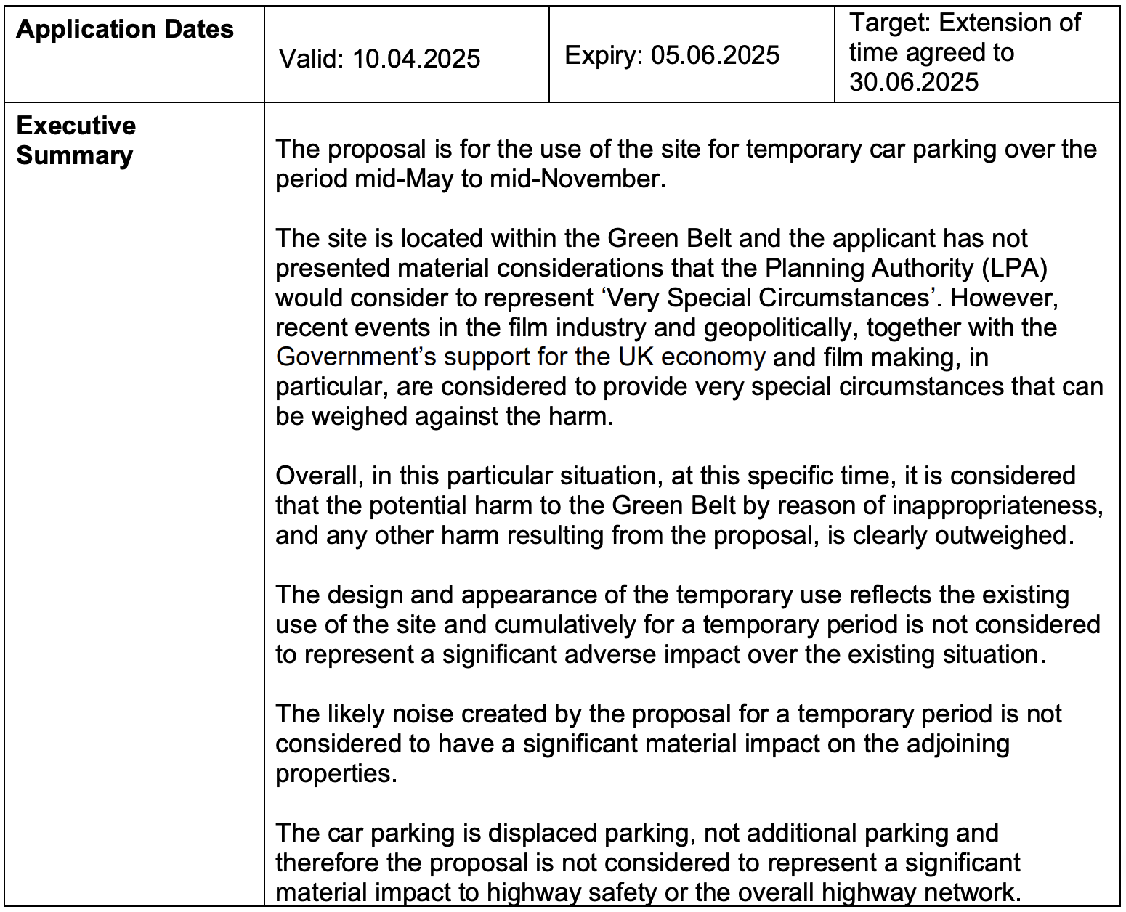
“Very Special Circumstances”
Overriding greenbelt protection via economic justification
Table 2: Planning application executive summary. Source: Spelthorne Borough Council (2025, p. 1).

Slide 45
Geovisualisation of Longcross vectors. Data sourced from OSM_AUDIT_2025 repository.
Notes:
And as we see in the Longcross sector on this map, this isn't just one studio; it's a systemic pattern of aggressively expanding into nature.

Slide 46
Synthesis: The Physical Body of the Cloud
An Eco-Marxist Critique of the Digital Spatial Fix
The Marxist Metabolic Rift: The forensic audit proves that “immaterial” cloud rendering requires the violent eradication of local biomass (NDVI Spatiotemporal Collapse).
The Digital Spatial Fix: Capital does not eliminate emissions; it displaces them. The film industry has anchored its ecological crisis into 13.2 hectares of asphalt and 17 high-voltage nodes.
The Thermodynamic Price: The controlled-BACI LST escalation (+0.56 °C across the polygon, +1.08 °C over the impervious core) is the direct, physical manifestation of Algorithmic Metabolism.
Accumulation by Dispossession: A £0 ecological provision within a £36,150 transport-only S106, set against £322.7M annual GVA, reveals the true political economy of greenwashing.

Slide 47
Bibliography & Institutional Archives
Reports and minutes
Finance and Accountancy (2023) Spelthorne Borough Council: Capital Assurance Review. London: Department for Levelling Up, Housing and Communities. Available at: https://assets.publishing.service.gov.uk/media/6634a07174933dccbbb6c1ed/Spelthorne_Report.pdf (Accessed: 6 March 2026).
Li, H. (2026) Strategic Governance and Institutional Interconnectivity: A Comprehensive Analysis of Interest Binding Between Spelthorne Borough Council, Pinewood Group, and Turley. [Unpublished Report].
Spelthorne Borough Council (2019) Printed Minutes: Planning Committee, Tuesday 12 February 2019. Staines-upon-Thames: Spelthorne Borough Council. Available at: https://democracy.spelthorne.gov.uk/documents/g2033/Printed%20minutes%20Tuesday%2012-Feb-2019%2018.45%20Planning%20Committee.pdf?T=1 (Accessed: 6 March 2026).
Spelthorne Borough Council (2025) Agenda Document for Business, Infrastructure and Growth Committee, 11 September 2025. Staines-upon-Thames: Spelthorne Borough Council.
Shepperton Studios Limited (2019) Briefing to Members of Planning Committee - February 2019. Staines-upon-Thames: Spelthorne Borough Council.
Notes:
Here are my theoretical and institutional sources.

